Slide 1
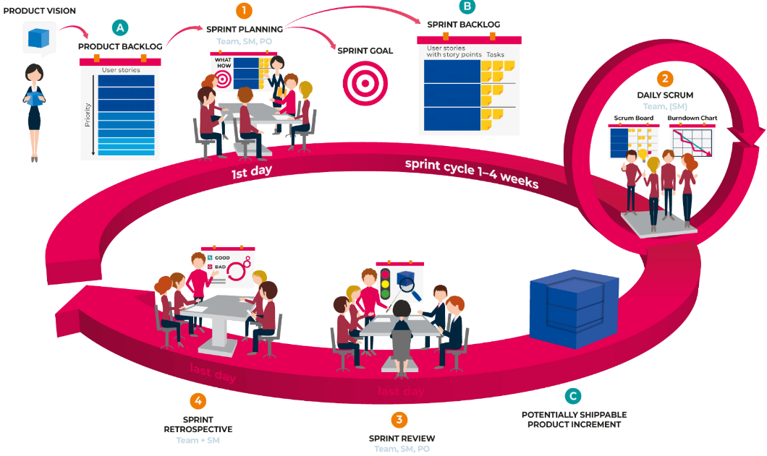
Agile IT Project Management
Manuel KOLP
manuel.kolp@uclouvain.be

Slide 2
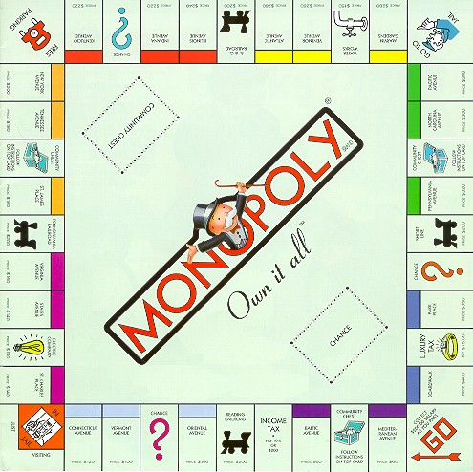
SPM
Software
Project
Management

Slide 3
Managing Software Projects
Software intensive products
Management 101: plan-do-check-act
What to manage?
Software development lifecycles
Key differences with other engineering disciplines
Plan-driven or agile, “degree of ceremony”
Role of standards
ISO, IEEE etc.
Notes:
The next slides just expand a bit on the outline, to give students a more complete picture of what there is to come.

Slide 4


For each “thing to manage”
Definitions
Good practices
(sometimes bad practices)
Techniques
Recipes, heuristics, guidelines
Tools
Standards
IEEE, ISO, ARINC, etc.
Examples from:
Rational Unified Process (RUP), SCRUM, KANBAN, …

Slide 5
DEVELOPMENT LIFE CYCLE

Slide 6
Systems Development Life Cycle (SDLC)
SDLC includes a systematic process of planning, designing, and creating an information system for organizations.
It is often better to have a structured methodology to avoid mishaps and coordinate the design and development tasks properly among the members of a large systems development team.
Systems Approach—Complex problems are broken up into smaller manageable problems using a systems’ hierarchy, and then developing a solution for each problem within the hierarchy.

Slide 7


WATERFALL vs. AGILE
WATERFALL
Waterfall is a linear approach to following the define sequence of events/ steps where each stage generally finishes before the next one can begin.
AGILE
Agile is an iterative approach where requirements and solutions evolve through the collaborative effort of self-organizing and cross-functional teams and their customer(s)/end user(s).

Slide 8
WATERFALL SOFTWARE DEVELOPMENT
The waterfall model is a software development process...
(First introduced by Dr. Winston W. Royce in a paper published in 1970)
The waterfall model emphasizes that a logical progression of steps be taken throughout the software development life cycle (SDLC), much like the cascading steps down an incremental waterfall.
Requirements
Design
Implementation
Verification
Deployment

Slide 9
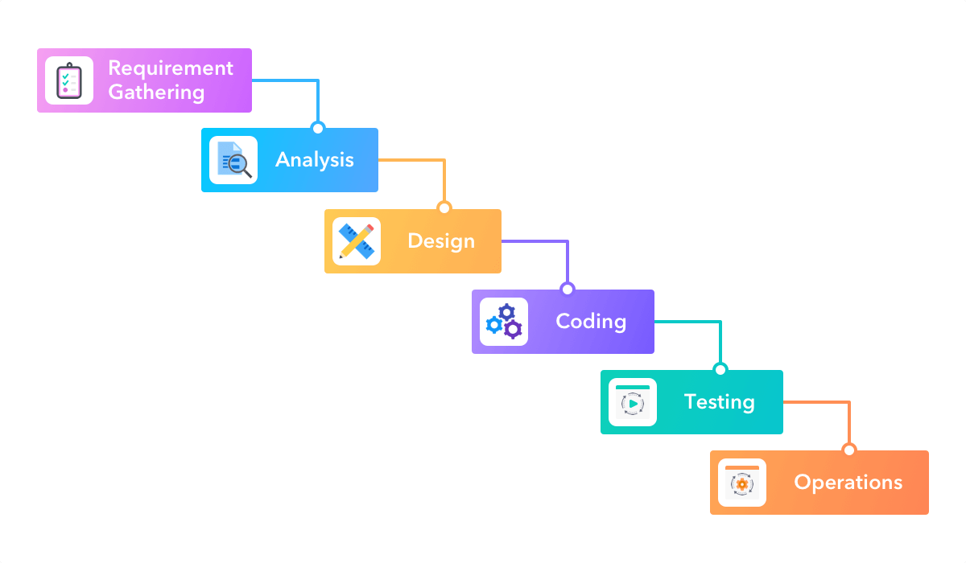
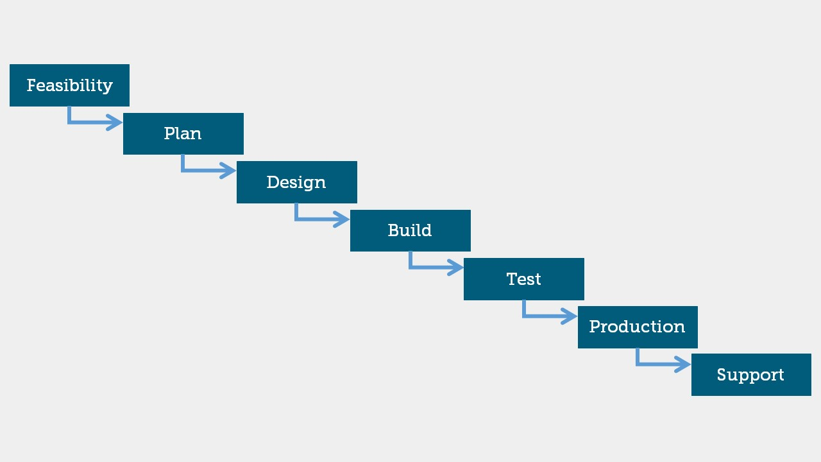
Waterfall Model: other phases

Slide 10
BUT ROYCE CONSIDERED WATERFALL RISKY ...
Requiremants
Design
Implementation
Verification
Maintenance
FEEDBACK LOOPS !
Royce pointed out that you’ll need feedback loops between every phase, and feedback all the way from test back to requirements.
Royce was actually trying to describe an iterative development cycle, NOT a sequential process!
“I believe in this concept, but the implementation described above is risky and invites failure.” - Royce

Slide 11

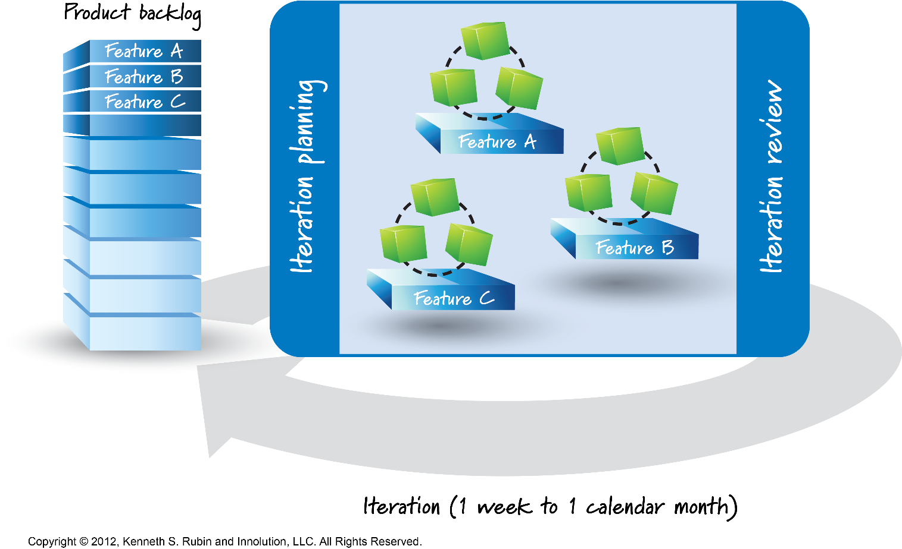
WHAT IS AGILE SOFTWARE DEVELOPMENT
Agile software development comprises various approaches to software development under which requirements and solutions evolve through the collaborative effort of self-organizing and cross-functional teams and their customer(s)/end user(s).
Agile software development advocates
adaptive planning
evolutionary development
early delivery
continual improvement
rapid and flexible response to change

Slide 12
Agile Development
Agile methodologies start with smaller sets of requirements, they start small and deliver functionality incrementally in a series of releases.
No single release covers all requirements, but every release delivers more than the previous one.
Users are able to provide feedback quickly on how the system meets their needs and also if a requirement is missing or wrong, it can be corrected quickly.
Two of the most popular implementations are:
Scrum- Much is left up to the project team.
Extreme programming (XP)- Stresses customer satisfaction and gives working software to the customers quickly and incorporates their feedback quickly.

Slide 13
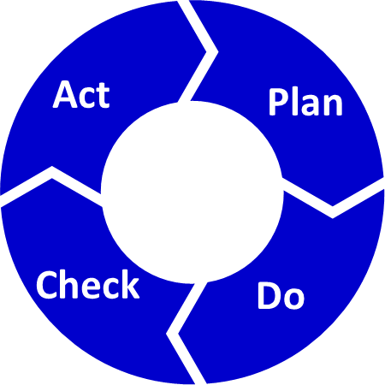
PDCA SDLC Methodology
Requirements
Analysis & Design
Planning
Implementation
Management
Environment
Test
Evaluation
Deployment

Slide 14
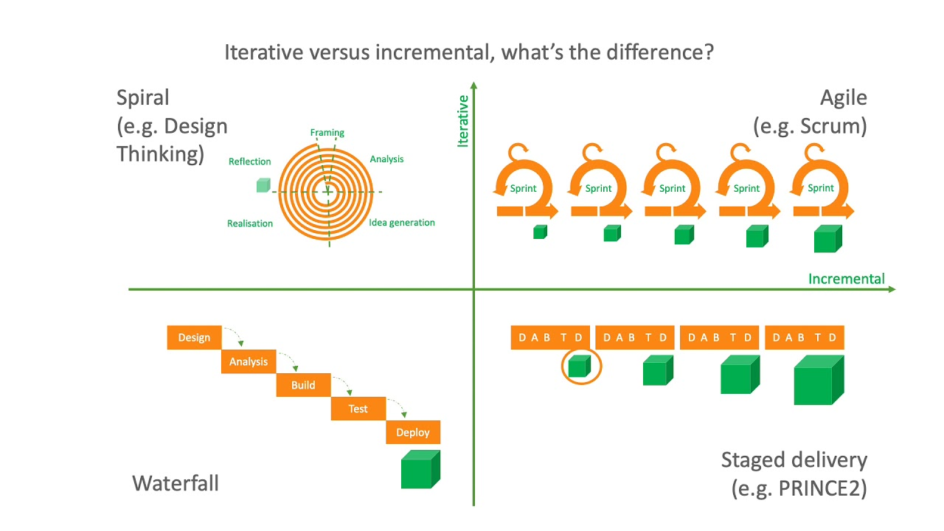
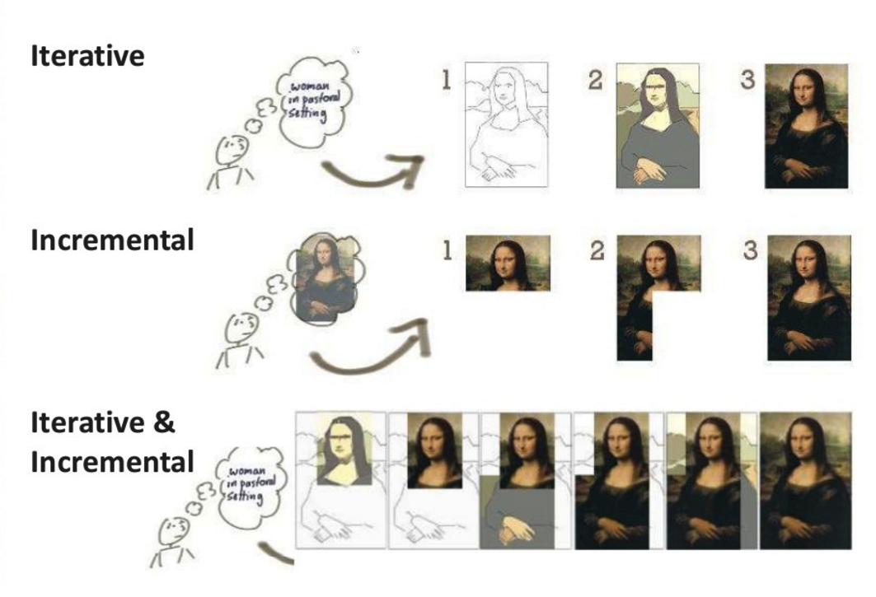
Iterative/Incremental

Slide 15
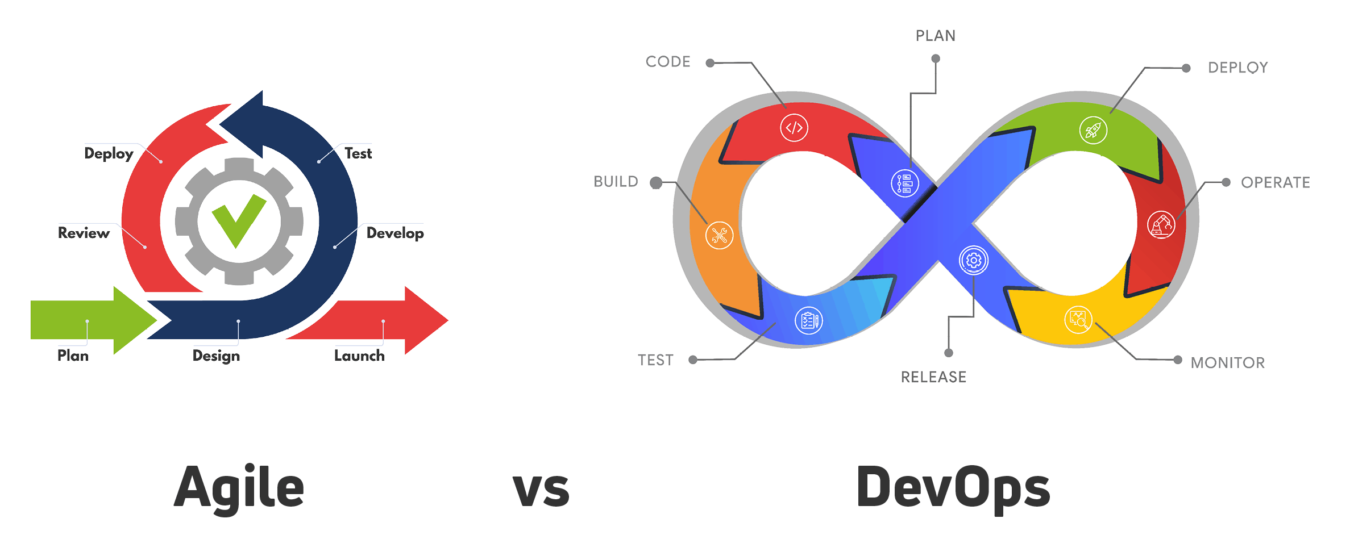
Is DevOps Agile Or (Double) PDCA?

Slide 16
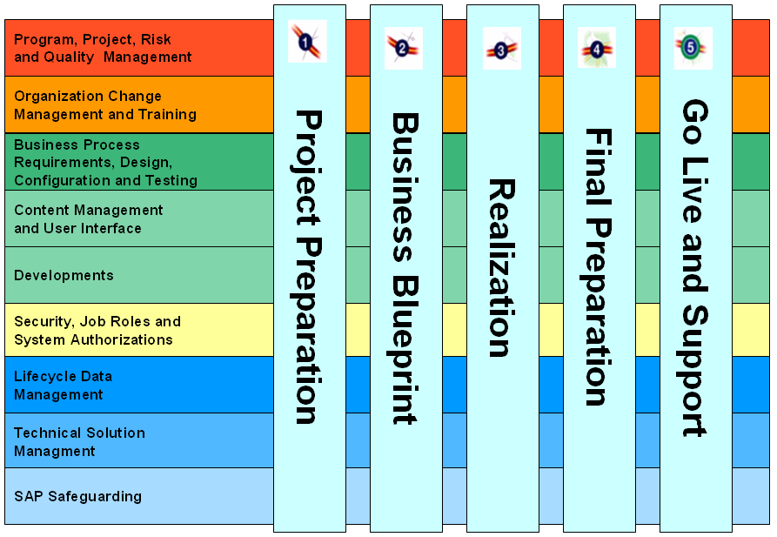
Exemple of Profile: ASAP

Slide 17
AGILE SOFTWARE DEVELOPMENT TARGETS...
Agile software development mainly targets complex systems and projects
... with dynamic, non- deterministic and non-linear characteristics,
... where accurate estimates, stable plans, and predictions are often hard to get in early stages—
... where big up-front designs and arrangements would probably cause a lot of waste, i.e., are not economically sound
When to use Agile software development..

Slide 18
AGILE MANIFESTO
Agile Manifesto is at the heart of any agile implementation…
We are uncovering better ways of developing software by doing it and helping others do it. Through this work we have come to value:
Individuals and interactions over Process and tools
Working software over Comprehensive documentation
Customer collaboration over Contract negotiation
Responding to change over Following a plan
That is, while there is value in the items on the right, we value the items on the left more.
Notes:
In 2001 seventeen software developers met at a resort in Snowbird, Utah to discuss lightweight development methods: Kent Beck, Ward Cunningham, Dave Thomas, Jeff Sutherland, Ken Schwaber, Jim Highsmith, Alistair Cockburn, Robert C. Martin, Mike Beedle, Arie van Bennekum, Martin Fowler, James Grenning, Andrew Hunt, Ron Jeffries, Jon Kern, Brian Marick, and Steve Mellor. Together they published the Manifesto for Agile Software Development.
As Scott Ambler elucidated:
Tools and processes are important, but it is more important to have competent people working together effectively.
Good documentation is useful in helping people to understand how the software is built and how to use it, but the main point of development is to create software, not documentation.
A contract is important but is no substitute for working closely with customers to discover what they need.
A project plan is important, but it must not be too rigid to accommodate changes in technology or the environment, stakeholders' priorities, and people's understanding of the problem and its solution.

Slide 19
12 PRINCIPLES OF AGILE SOFTWARE DEVELOPMENT
The Manifesto for Agile Software Development is based on twelve principles:
Early and continuous delivery of valuable software
Welcome changing requirements
Deliver working software frequently
Business people and developers must work together
Motivated individuals produce the best results
Face-to-face conversation is the most valuable
Progress is measured by working software
Enforce a sustainable development pace
Technical excellence enhances agility (and quality)
Simplicity
Self-organizing teams produce the best solutions
At regular intervals, the team adjusts its behavior to become more effective
Notes:
Twelve Principles of Agile Software
Our highest priority is to satisfy the customer through early and continuous delivery of valuable software.
Welcome changing requirements, even late in development. Agile processes harness change for the customer's competitive advantage.
Deliver working software frequently, from a couple of weeks to a couple of months, with a preference to the shorter timescale.
Business people and developers must work together daily throughout the project.
Build projects around motivated individuals. Give them the environment and support they need, and trust them to get the job done.
The most efﬁcient and effective method of conveying information to and within a development team is face-to-face conversation.
Working software is the primary measure of progress.
Agile processes promote sustainable development. The sponsors, developers, and users should be able to maintain a constant pace indeﬁnitely.
Continuous attention to technical excellence and good design enhances agility.
Simplicity – the art of maximizing the amount of work not done – is essential.
The best architectures, requirements, and designs emerge from self-organizing teams.
At regular intervals, the team reﬂects on how to become more effective, then tunes and adjusts its behavior accordingly.

Slide 20

THE AGILE WORLD
Agile is much more than Scrum...
There are many specific agile development methods. Most promote development, teamwork, collaboration, and process adaptability throughout the life- cycle of the project
AGILE
Organization culture
Scrum
Kanban
Self organizing teams
eXtreme Programming
Organizational change
Feature Driven Development (FDD)
...
Crystal family
...

Slide 21
ADAPTIVE vs. PREDICTIVE
ADAPTIVE:
Agile methods lie on the adaptive side of this continuum.
One key of adaptive development methods is a "Rolling Wave" approach to schedule planning, which identifies milestones but leaves flexibility in the path to reach them, and also allows for the milestones themselves to change.
Adaptive methods focus on adapting quickly to changing realities. When the needs of a project change, an adaptive team changes as well.
PREDICTIVE:
Predictive methods, focus on analyzing and planning the future in detail and cater for known risks.
In the extremes, a predictive team can report exactly what features and tasks are planned for the entire length of the development process.
Predictive methods rely on effective early phase analysis and if this goes very wrong, the project may have difficulty changing direction.
Predictive teams often institute a change control board to ensure they consider only the most valuable changes.

Slide 22
AGILE SW DEVELOPMENT IN A NUT SHELL
Product development work is broken into small increments that minimize the amount of up-front planning and design
Iterations, or sprints, are short time frames that typically last from one to four weeks.
Each iteration involves a cross-functional team working in all functions: planning, analysis, design, coding, unit testing, and acceptance testing.
At the end of the iteration a working product is demonstrated to stakeholders. This minimizes overall risk and allows the product to adapt to changes quickly.
Note: An iteration might not add enough functionality to warrant a market release, but the goal is to have an available release (with minimal bugs) at the end of each iteration.
Multiple iterations might be required to release a product or new features.
Working software is the primary measure of progress.

Slide 23
AGILE METHODS
Adaptive software development (ASD)
Agile modeling
Unified process (UP, RUP, OpenUP, AUP, EUP)
Disciplined agile delivery (DAD)
Dynamic systems development method (DSDM)
Extreme programming (XP)
Feature-driven development (FDD)
Lean software development
Lean startup
Kanban
Rapid application development (RAD)
Scrum
Scrumban
Scaled Agile Framework - SAFe

Slide 24
AGILE SOFTWARE DEVELOPMENT PRACTICES
Agile software development is supported by a number of concrete practices, covering areas like requirements, design, modeling, coding, testing, planning, risk management, process, quality, etc. E.g.:
Acceptance test-driven development (ATDD)
Agile modeling
Agile testing
Backlogs (Product and Sprint)
Behavior-driven development (BDD)
Continuous integration (CI)
Cross-functional team
Daily Stand-up / Daily Scrum
Domain-driven design (DDD)
Iterative and incremental development (IID)
Low-code development platforms
Pair programming
Planning poker
Refactoring
Retrospective
Scrum events (sprint planning, sprint review and retrospective)
Specification by example
Story-driven modeling
Test-driven development (TDD)
Timeboxing
User story
Velocity tracking

Slide 25
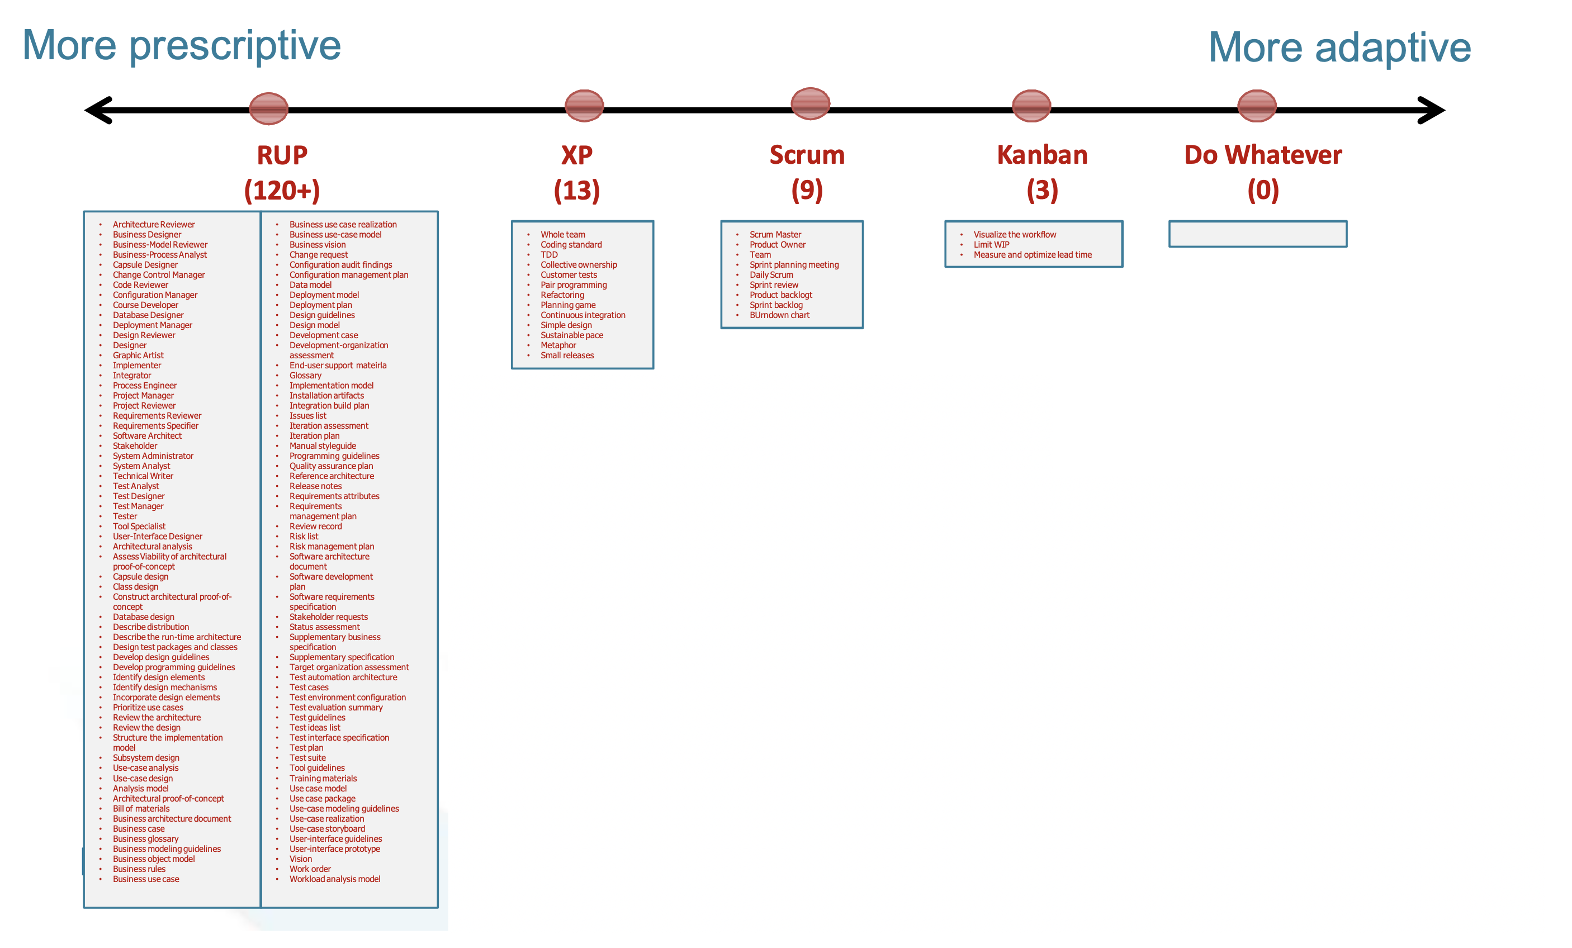
From Prescriptive to Adaptative

Slide 26
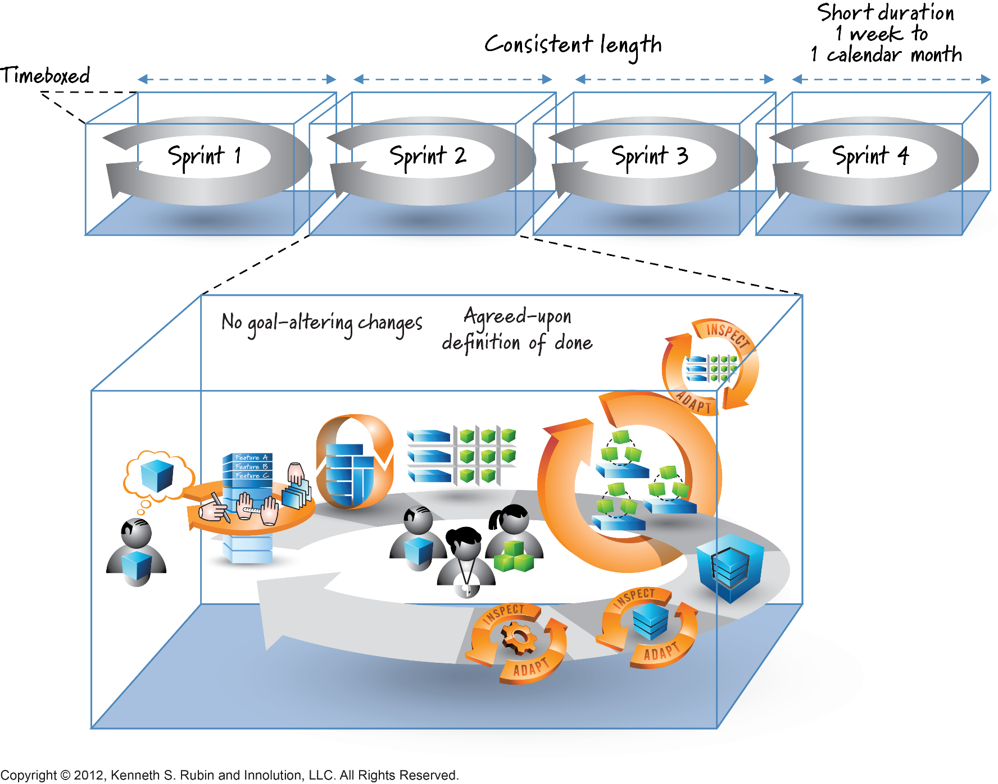
Agile Development : SCRUM

Slide 27
IT Project Management Process

Slide 28
Project Characteristics
Objectives
Clearly defined set of goals; non conflicting
Start and end points
not a continuous activity, like operations or support
Uniqueness
One time thing (product); not a repetitive activity
Not production
Constraints
Cost, schedule, quality
Source: Futrell
Notes:
A project is not like just IT support.

Slide 29
Triangle of Constraints
Quality
SCOPE
Time
Resources

Slide 30
Defining Software Project Management
Software Project Management is the art of balancing competing objectives, managing risks, and overcoming constraints to successfully deliver a product which meets the needs of both customers (the payers of bills) and the users.
Project management is the application of knowledge, skills, tools, and techniques to project activities in order to meet or exceed stakeholder needs and expectations from a project (Project Management Institute)

Slide 31


Management & Engineering
Planning, coordinating, leading, controlling
Focused on people, teams, products & work
Analyzing, designing, building, testing
Focused on the quality of the technical solution
Notes:
The roles of the developers and the managers are related but distinct. Often in small projects these boundaries are vague. Or a techie promoted into a manager’s position will mix things up and not do a good job at one or the other.

Slide 32
Stages in Software Project Control
Chaos
Controls: minimal
Mantra: Just do it!
Lifecycle: undefined
Prescriptive Control
Controls: conformance to plan
Mantra: Plan the work and work the plan
Lifecycle: Waterfall & Task-based (or WBS)
Adaptive control
Controls: conformance to acceptable results
Mantra: Embrace change
Lifecycle: iterative, feature-driven
Source: Jim Highsmith
Notes:
Our view of “control” also evolves as an organization matures. But often it get stuck in prescriptive stage, which is still the case for many large organizations

Slide 33
Process
Process: set of activities intended to achieve a goal
Process to run a project
= software development process
= software engineering process
= software process
Software project management is a subset of that software development process
Notes:
Process = the recipes used by a project team to develop software. One key sub-process is project management.

Slide 34
Examples of Processes
Rational Unified Process (UP)
Dynamic System Development Method (DSDM)
Microsoft Solution Framework (MSF)
eXtreme programming (XP)
MERISE
SCRUM
KANBAN
SCRUMBAN
ASAP

Slide 35
Examples of Process Frameworks
Capability Maturity Model (CMM)
A process assessment framework
IEEE 1074: Standard for Developing Software Lifecycle Processes
ISO/IEC 12207: Software Lifecycle Processes
Project Management Body of Knowledge (PMBOK)
Notes:
A process framework is not a process that can be executed. it is used either to develop a process, or to analyze a process. it must be complement by concrete recipes.
It does not mean much for an organization that they use ISO 12207 or CMM as their process. It only indicate the structure and jargon they use.

Slide 36
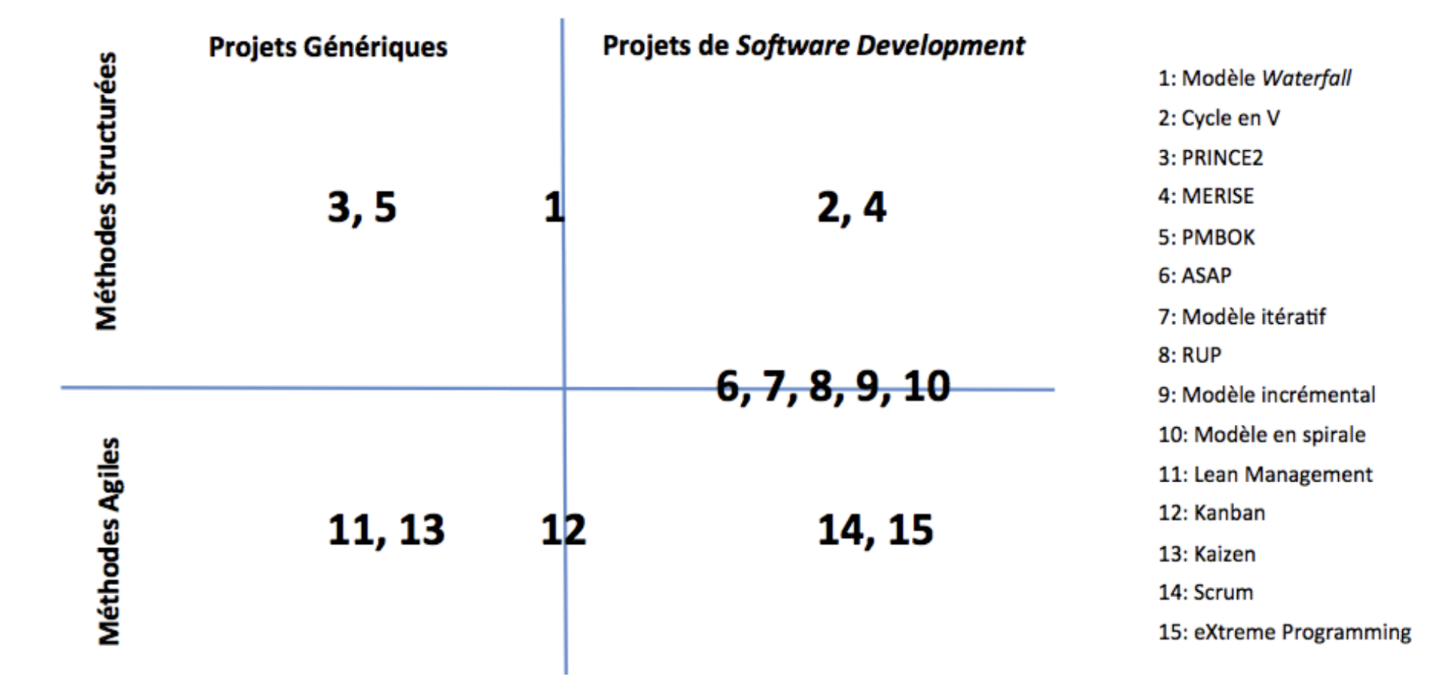
Tentative Positioning

Slide 37
Process Basics
Lifecycle
Phases, milestone
Work products, artifacts
concrete “things” delivered or internal
Activities, task
things to do, recipes on how to do it
Workflows
meaningful sequences of activities
Roles
skills, competencies, responsibilities

Slide 38
Example of process: MSF-MOF
Microsoft Solution Framework
Plan
Build
Operate
Deploy
Microsoft Operations Framework
Source: Microsoft, MSF v3

Slide 39
MSF - Lifecycle
Envisioning
Vision & scope approved
Project plan approved
Scope complete
Release Readiness Complete
Deployment Complete
Deploying
Planning
Developing
Stabilizing
Source: Microsoft, MSF v3

Slide 40
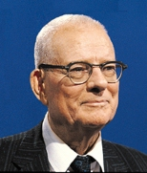
Project Management 101: PDCA
Plan
Do
Check
Act
Deming Cycle
Deming called it Shewhart Cycle
Plan the short term objective
Determine the time-frame
Decide what will be needed
Decide who is doing what
Do what the plan said
Collect data
Design studies or other stuff
Train people …
W. Edward
Deming
Notes:
This was invented in the late 1930’s.

Slide 41
Project Management Body of Knowledge
PMBOK: Developed by the Project Management Institute (PMI) (USA)
Initial publication in 1987
Adopted by IEEE as IEEE 1490-1998
NOT software specific
A certification: Project Management Professional (PMP)
Source: PMI & IEEE
Notes:
This has become the main beacon, the main reference for project managers in general. It is however unfortunate that it is not quite well suited to software development, as we will see throughout the course.

Slide 42
PMBOK: Knowledge Areas
1. Project Integration management
2. Project Scope management
3. Project Time management
4. Project Cost management
5. Project Quality management
6. Project Human resources management
7. Project Communication management
8. Project Risk management
9. Project Procurement management
Notes:
And we notice that MSFT did not go too far to organize the management part of MSF. The project management discipline of RUP is also heavily inspired by the PMBOK, at the outermost level.

Slide 43
Project Management Body of Knowledge
Project Integration Management
Project Scope Management
Project Time Management
Project Plan Development
Project Plan Execution
Integrated Change Control
Initiation
Scope Planning
Scope Definition
Scope Verification
Scope Change Control
Activity Definition
Activity Sequencing
Activity Duration Estimation
Schedule Development
Schedule Control
Project Cost Management
Project Quality Management
Project Human Resource Management
Resource Planning
Cost Estimating
Cost Budgeting
Quality Planning
Quality Assurance
Quality Control
Organizational Planning
Staff Acquisition
Team Development
Project Communications Management
Project Risk Management
Project Procurement Management
Communications Panning
Information Distribution
Performance Reporting
Administrative Closure
Risk Management Planning
Risk Identification
Qualitative Risk Analysis
Quantitative Risk Analysis
Risk Response Planning
Risk Monitoring & Control
Procurement Planning
Solicitation Planning
Solicitation
Source Selection
Contract Administration
Contract Closeout
Source: E. Lopes Cardozo, Empulsys
Notes:
It is quite encyclopedic.

Slide 44
PMI’s PMBOK Concepts
Plan Development
Project Integration Management
Plan Execution
Project Scope Management
Change Control
Project Time Management
Project Cost Management
Quality Planning
Knowledge Areas
Project Quality Management
Quality Assurance
PM Processes
Project Procurement Management
Quality Control
Project Communications Management
Initiating
Project Risk Management
Organization Planning
Project Human Resource Management
Staff Acquisition
Planning
Team Development
Executing
Process Groups
Controlling
Closing

Slide 45
PMI PMBOK: Focus over Time
Executing
Project Integration Mgmt
Project Plan Execution
Project Quality Mgmt
Quality Assurance
Level
of
Activity
Planning
Project HR Mgmt
Team Development
Project Communication Mgmt
Information Distribution
Project Procurement Mgmt
Solicitation
Source Selection
Contract Admin
Initiating
Closing
Controlling
Phase Start
Time
Phase End
PMBOK® Guide 2000, Project Management Institute, Inc.

Slide 46
Looking into the PMBOK Philosophy
Traditional Focus (PMBOK)
Initiating
Processes
Planning
Processes
Planning
Processes
Planning Processes
Controlling
Processes
Controlling
Processes
Executing
Processes
Executing
Processes
Controlling Processes
Executing Process
Heavy Planning Emphasis
Little Execution Guidance
Construction Inspired
Closing
Processes
Sources: L. Koskela & Mike Griffiths

Slide 47
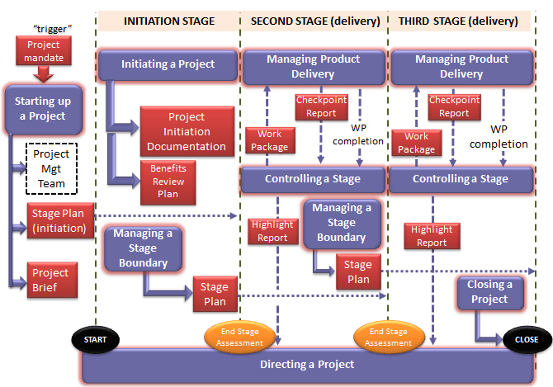
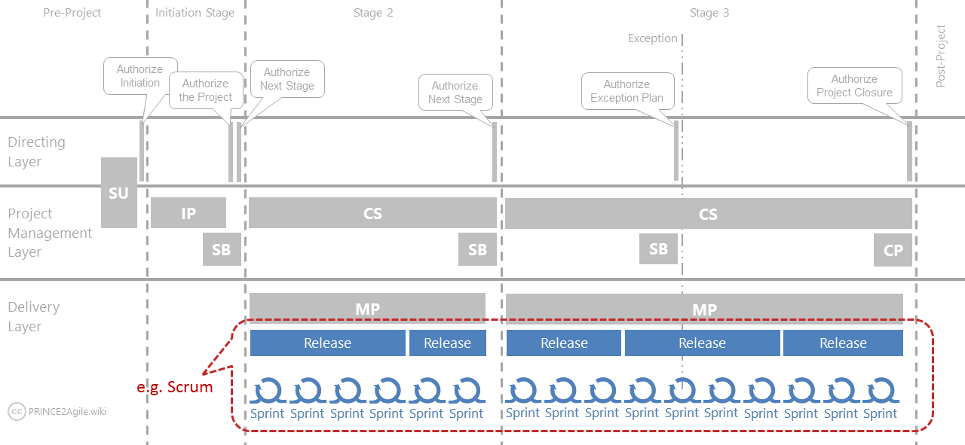
PRINCE 2 Profile ( to Agile)

Slide 48
Counterpoint to planning: Emergence
Agile processes:
The requirements, the design, the process and therefore the product will gradually emerge as the project proceed.
Very little planning, only rough sketches and envelopes at first.
Immediate feedback allows driving the project (very short Deming cycles; few artifacts).
Practices to support this paradigm: Test first, customer on site, Pair Programming, Scrums, Planning game, etc…
Notes:
Leading into agile processes….. from plan-driven to highly adaptive.

Slide 49
Agile Manifesto: Values & Principles
Individuals and interactions over process and tools
Working software over comprehensive documents
Customer collaboration over contract negotiation
Responding to change over following a plan.
Customer satisfaction
Change is OK
Deliver working software frequently
Business people and developers must work together daily
Motivated individuals; right environment; trust
Face-to-face communication is preferred
Sustainable development
Continuous attention to technical excellence
Simplicity
Emergence of architecture, requirements and design
Self-organizing teams
Self-reflection to become more effective
Notes:
The Agile Manifesto is quite simple, but can be interpreted way over board….

Slide 50
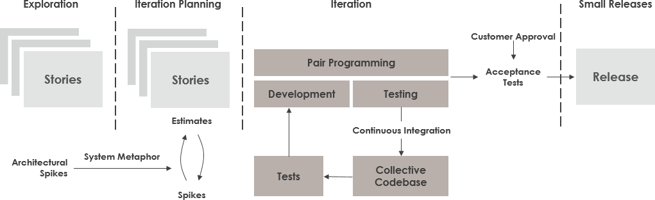
More Value, Principles and Practices: XP
Through basic values, principles, and practices
Five values: communication, simplicity, feedback, courage, respect
These values represent a specific mindset of motivated team players who do their best on the way to achieving a common goal

Slide 51
XP values – Communication & Simplicity
Communication
With the customer and amongst the team
Communicating system requirements to the developers of the system
Providing a shared view (of the system) between users and developers
Through simple design, common metaphors, collaboration, frequent verbal communication, and feedback
Simplicity
Start with the simplest solution and improve to better ones
Focus on the minimalistic solution
Focus on designing and coding for the needs of today instead of those of tomorrow
Improving the quality of communication

Slide 52
XP values – Feedback & Courage
Feedback
Relates to different dimensions of the system development
Feedback from the system: unit tests, periodic integration tests
Feedback from the customer: functional tests (aka acceptance tests) written by the customers and the testers.
Feedback from the team: when customers come up with new requirements in the planning game the team directly gives an estimation of the time that it will take to implement
Courage to take on problems proactively and integrate testing and changes in the development phase
Always design and code for today and not for tomorrow
Know when to throw code away
Persistence

Slide 53
XP values - Respect
Respect for others as well as self respect
The members of the team need to respect each other, provide and accept feedback that honours their relationship, and to work together to identify simple designs and solutions
Programmers should never commit changes that break compilation, that make existing unit-tests fail, or that otherwise delay the work of their peers

Slide 54
XP principles – Rapid feedback & Assume Simplicity
Feedback
Feedback is most useful if it is done rapidly
The time between an action and its feedback is critical in learning and making changes
The customer can give feedback and steer the development as needed
Unit tests contribute to the rapid feedback principle.
Simplicity
Treat every problem as if it can be solved with simplicity
Traditionally: plan for the future, do the work planned! Result: what is required today by the customer is not met and what is ultimately delivered may be obsolete and difficult to change
Solve today’s job today and trust your ability to add complexity in the future where you need it
Focus on what is important today!

Slide 55
XP principles – Incremental change
Big changes made all at once just do not work
Any problem is solved with a series of the smallest change that makes a difference
In XP, incremental change is applied in many ways:
The design changes a little at a time
The plan changes a little at a time
The team changes a little at a time
Even the adoption of XP must be taken in little steps

Slide 56

XP principles – Embracing change & Quality Work
Change
Do not work against changes but embrace them
EX. Change in customer’s requirements
Quality
Everyone in the team likes doing a good job
The team works well, enjoys the work and feels good in producing a product of value
A team that works well, makes a valuable product and feels proud of it

Slide 57
XP practices
XP has 12 practices grouped in four areas:
Fine-Scale feedback: the planning game, pair programming, on-site customer, test-driven development
Continual process: continuous integration, code refactoring, small releases (building blocks)
Shared understanding: simple design, collective code ownership, system metaphor (standardized naming schemes), coding standards
Programmer’s welfare: 40-hour week

Slide 58
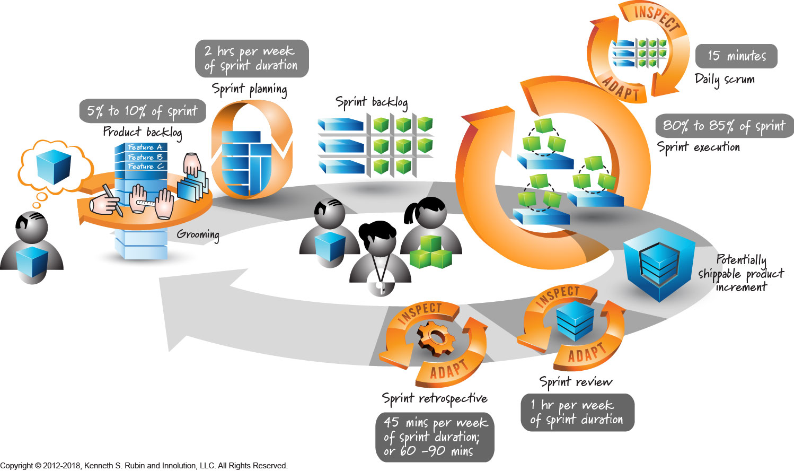
Agile with SCRUM
Sprint Cycle: 1 – 4 weeks

Slide 59

SCRUM
“Scrum is an enhancement of the commonly used iterative/incremental object-oriented development cycle”
—Jeff Shuterland

Slide 60
SCRUM HISTORY
1986: Scrum was first defined as "a flexible, holistic product development strategy where a development team works as a unit to reach a common goal" as opposed to a "traditional, sequential approach" by Hirotaka Takeuchi and Ikujiro Nonaka in the "New New Product Development Game"
Early 1990’s: Ken Schwaber used what would become Scrum at his company, Advanced Development Methods, and Jeff Sutherland, with John Scumniotales and Jeff McKenna, developed a similar approach at Easel Corporation, and were the first to refer to it using the single word Scrum
2001: Ken Schwaber worked with Mike Beedle to describe the method in the book Agile Software Development with Scrum
1986
1990’s
2001

Slide 61
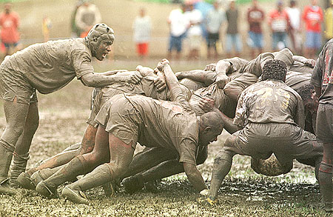
SCRUM IN RUGBY...
A scrum is a method of restarting play in rugby football that involves players packing closely together with their heads down and attempting to gain possession of the ball.

Slide 62
SCRUM IN PRODUCT DESIGN...
Product design should be... „More like a team sport, less like an assembly line”...
“Under the rugby approach, the product development process emerges from the constant interaction of a hand-picked, multidisciplinary team whose members work together from start to finish.”
– Takeuchi & Nonaka
In the 1986 Harvard Business Review paper “The New New Product Development Game,” Takeuchi and Nonaka studied a variety of product design teams and found that the most successful had derived a process that looked chaotic on the outside, but was ultimately faster and more effective at creating great products. They compared these teams work- practice to the sport Rugby.

Slide 63

SCRUM IN „NON-RUGBY” CONTEXT...
Scrum: A framework within which people can address complex adaptive problems, while productively and creatively delivering products of the highest possible value.
Scrum is not an acronym
Scrum is named after the game of Rugby in which a group is responsible for picking up the ball and moving it forward.

Slide 64
WHAT IS A SPRINT
The Sprint is a container for all other events.
Sprint is a time-box of one month or less during which a "Done", useable, and potentially releasable product Increment is created.
Sprints have consistent durations throughout a development effort.
A new Sprint starts immediately after the conclusion of the previous Sprint.

Slide 65
SCRUM DEVELOPMENT IN A NUT SHELL
Product development work is broken into small increments that minimize the amount of up-front planning and design
Iterations, or sprints, are short time frames that typically last from one to four weeks.
Each iteration involves a cross-functional team working in all functions: planning, analysis, design, coding, unit testing, and acceptance testing.
At the end of the iteration a working product is demonstrated to stakeholders. This minimizes overall risk and allows the product to adapt to changes quickly.
Note: An iteration might not add enough functionality to warrant a market release, but the goal is to have an available release (with minimal bugs) at the end of each iteration.
Multiple iterations might be required to release a product or new features.
Working product is the primary measure of progress.

Slide 66
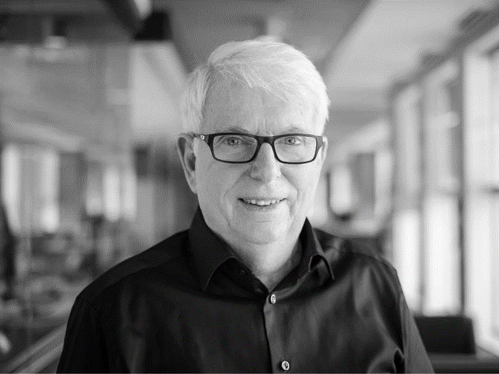
SCRUM...
“Scrum assumes that the systems development process is an unpredictable, complicated process that can only be roughly described as an overall progression.”
― Jeff Sutherland

Slide 67
„SCRUM... OR NOT TO SCRUM – THAT IS THE QUESTION”
USE SCRUM WHEN,,,
requirements are not clearly defined.
work is delivered in increments
work is measured and controlled
productivity is maximized by applying known technologies
organizations are willing to do anything and everything for a project to succeed
project is important and no one has confidence that any existing approach will work.
control and management is Empirical
WHEN TO AVOID SCRUM,,,
there isn’t a flexible environment
corporate culture isn’t conducive to this of development environment
teams of developers are more than 10 (Six is ideal).
Cost is a major issue
No management support
No formal training available

Slide 68
SCRUM DEFINITION ...as in Scrum Guide
Scrum is a lightweight framework that helps people, teams and organizations generate value through adaptive solutions for complex problems.
In a nutshell, Scrum requires a Scrum Master to foster an environment where:
A Product Owner orders the work for a complex problem into a Product Backlog.
The Scrum Team turns a selection of the work into an Increment of value during a Sprint.
The Scrum Team and its stakeholders inspect the results and adjust for the next Sprint.
REPEAT
The Scrum framework is purposefully incomplete, only defining the parts required to implement Scrum theory.
Scrum is built upon by the collective intelligence of the people using it. Rather than provide people with detailed instructions, the rules of Scrum guide their relationships and interactions.
Source : Scrum Guide
Notes:
Scrum Definition
Scrum is a lightweight framework that helps people, teams and organizations generate value through adaptive solutions for complex problems.
In a nutshell, Scrum requires a Scrum Master to foster an environment where:
1.A Product Owner orders the work for a complex problem into a Product Backlog.
2.The Scrum Team turns a selection of the work into an Increment of value during a Sprint.
3.The Scrum Team and its stakeholders inspect the results and adjust for the next Sprint.
4.Repeat
Scrum is simple. Try it as is and determine if its philosophy, theory, and structure help to achieve goals and create value. The Scrum framework is purposefully incomplete, only defining the parts required to implement Scrum theory. Scrum is built upon by the collective intelligence of the people using it. Rather than provide people with detailed instructions, the rules of Scrum guide their relationships and interactions.
Various processes, techniques and methods can be employed within the framework. Scrum wraps around existing practices or renders them unnecessary. Scrum makes visible the relative efficacy of current management, environment, and work techniques, so that improvements can be made.

Slide 69
SCRUM ARTIFACTS ( and COMMITMENTS)
Scrum’s artifacts represent work or value. They are designed to maximize transparency of key information. Thus, everyone inspecting them has the same basis for adaptation.
Each artifact contains a commitment to ensure it provides information that enhances transparency and focus against which progress can be measured:
For the Product Backlog it is the Product Goal.
For the Sprint Backlog it is the Sprint Goal.
For the Increment it is the Definition of Done.
These commitments exist to reinforce empiricism and the Scrum values for the Scrum Team and their stakeholders.
3 ARTIFACTS
(and commitments)
Product Backlog (Product Goal)
Sprint Backlog (Sprint Goal)
Increment (Definition of Done)
Notes:
Scrum Artifacts
Scrum’s artifacts represent work or value. They are designed to maximize transparency of key
information. Thus, everyone inspecting them has the same basis for adaptation.
Each artifact contains a commitment to ensure it provides information that enhances transparency and focus against which progress can be measured:
For the Product Backlog it is the Product Goal.
For the Sprint Backlog it is the Sprint Goal.
For the Increment it is the Definition of Done.
These commitments exist to reinforce empiricism and the Scrum values for the Scrum Team and their stakeholders.

Slide 70
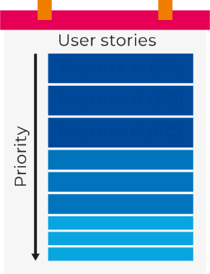
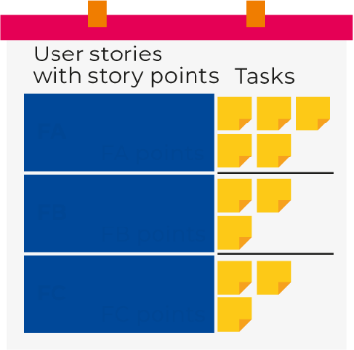
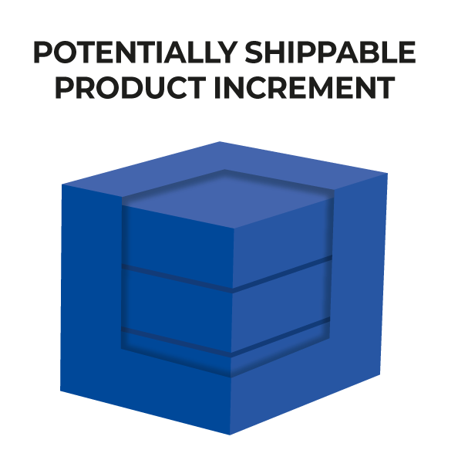
SCRUM ARTIFACTS
Product Backlog
2. Sprint Backlog
(Latin artifact roughly translate to “Work of Art”)
Scrum’s artifacts represent work or value in various ways that are useful in providing transparency and opportunities for inspection and adaptation.
Primary Scrum artifacts are
Product Backlog
Sprint Backlog
Increment
Feature A (FA)
Feature B (FB) Feature C (FC)
FA FA points
FB FB points
FC FC points
3. Increment

Slide 71
SCRUM TEAM
The fundamental unit of Scrum is a small team of people, a Scrum Team.
The Scrum Team is a a self-organizing team consisting of a
one Product Owner,
one Scrum Master
Development Team /Developers
Within a Scrum Team, there are no sub-teams or hierarchies. It is a cohesive unit of professionals focused on one objective at a time, the Product Goal.
The Scrum Team is small enough to remain nimble and large enough to complete significant work within a Sprint, typically 10 or fewer people.
In general, smaller teams communicate better and are more productive.
SCRUM TEAM
Product Owner (PO)
Scrum Master (SM)
Development Team (DT)
Notes:
Scrum Team: a self-organizing team consisting of a Product Owner, Development Team and Scrum Master.
Scrum Team
The fundamental unit of Scrum is a small team of people, a Scrum Team. The Scrum Team consists of one Scrum Master, one Product Owner, and Developers. Within a Scrum Team, there are no sub-teams or hierarchies. It is a cohesive unit of professionals focused on one objective at a time, the Product Goal.
Scrum Teams are cross-functional, meaning the members have all the skills necessary to create value each Sprint. They are also self-managing, meaning they internally decide who does what, when, and how.
The Scrum Team is small enough to remain nimble and large enough to complete significant work within a Sprint, typically 10 or fewer people. In general, we have found that smaller teams communicate better and are more productive. If Scrum Teams become too large, they should consider reorganizing into multiple cohesive Scrum Teams, each focused on the same product. Therefore, they should share the same Product Goal, Product Backlog, and Product Owner.
The Scrum Team is responsible for all product-related activities from stakeholder collaboration, verification, maintenance, operation, experimentation, research and development, and anything else that might be required. They are structured and empowered by the organization to manage their own work. Working in Sprints at a sustainable pace improves the Scrum Team’s focus and consistency. The entire Scrum Team is accountable for creating a valuable, useful Increment every Sprint. Scrum defines three specific accountabilities within the Scrum Team: the Developers, the Product Owner, and the Scrum Master.

Slide 72



SCRUM TEAM
Product Owner (PO)
Product Owner (PO) is accountable for maximizing the value of the product resulting from the work of the Scrum Team ( i.e. represents the interests of stakeholders, develops and explicitly communicates the Product Goal, sets priorities, manages the Product backlog and is responsible for the final product)
Scrum Master (SM)
Scrum Master (SM) is accountable for establishing Scrum as defined in the Scrum Guide.
Scrum Masters are true leaders who serve the Scrum Team and the larger organization
Developers / Development team (DT)
Developers are the within a Scrum Team accountable for managing, organizing and doing all development work required to create a releasable Increment of product every Sprint i.e. estimate size of Sprint backlog items, track work progress every day (Daily Scrum), turn Sprint backlog list into Potentially shippable product increment.
Notes:
Product Owner: Role in Scrum accountable for maximizing the value of a product, primarily by incrementally managing and expressing business and functional expectations for a product to the Development Team(s).
Scrum Master: Role within a Scrum Team accountable for guiding, coaching, teaching and assisting a Scrum Team and its environments in a proper understanding and use of Scrum.
Development Team: Role within a Scrum Team accountable for managing, organizing and doing all development work required to create a releasable Increment of product every Sprint.

Slide 73
SCRUM EVENTS
Scrum employs an iterative, incremental approach to optimize predictability and to control risk.
5 SCRUM EVENTS:
Scrum combines four formal events for inspection and adaptation within a containing event, the Sprint
These events work because they implement the empirical Scrum pillars of
transparency,
inspection, and
adaptation.
5 SCRUM EVENTS
Sprint
Sprint Planning
Daily Scrum
Sprint Review
Sprint Retrospective
Notes:
Scrum Theory
The Sprint is a container for all other events. Each event in Scrum is a formal opportunity to inspect and adapt Scrum artifacts. These events are specifically designed to enable the transparency required.
Failure to operate any events as prescribed results in lost opportunities to inspect and adapt. Events are used in Scrum to create regularity and to minimize the need for meetings not defined in Scrum.
Optimally, all events are held at the same time and place to reduce complexity.
Scrum is founded on empiricism and lean thinking. Empiricism asserts that knowledge comes from experience and making decisions based on what is observed. Lean thinking reduces waste and focuses on the essentials.
Scrum employs an iterative, incremental approach to optimize predictability and to control risk. Scrum engages groups of people who collectively have all the skills and expertise to do the work and share or acquire such skills as needed.
Scrum combines four formal events for inspection and adaptation within a containing event, the Sprint. These events work because they implement the empirical Scrum pillars of transparency, inspection, and adaptation.
Transparency
The emergent process and work must be visible to those performing the work as well as those receiving the work. With Scrum, important decisions arebased on the perceived state of its three formal artifacts. Artifacts that have low transparency can lead to decisions that diminish value and increase risk
Transparency enables inspection. Inspection without transparency is misleading and wasteful.
Inspection
The Scrum artifacts and the progress toward agreed goals must be inspected frequently and diligently to detect potentially undesirable variances or problems. To help with inspection, Scrum provides cadence in the form of its five events.
Inspection enables adaptation. Inspection without adaptation is considered pointless. Scrum events are designed to provoke change.
Adaptation
If any aspects of a process deviate outside acceptable limits or if the resulting product is unacceptable, the process being applied or the materials being produced must be adjusted. The adjustment must be made as soon as possible to minimize further deviation.
Adaptation becomes more difficult when the people involved are not empowered or self-managing. A Scrum Team is expected to adapt the moment it learns anything new through inspection

Slide 74
SCRUM EVENTS
Prescribed events used in Scrum create regularity and minimize the need for meetings not defined in Scrum. Scrum events are:
Sprint
Sprint Planning
Daily Scrum / Standups
Sprint Review
Sprint Retrospective
(Backlog Refinement (Backlog grooming))
– each with their own timebox and deliverables.
Rules and meetings are aggressively simplified to optimise work flows and minimise waste.
Notes:
Scrum Events
The Sprint is a container for all other events. Each event in Scrum is a formal opportunity to inspect and adapt Scrum artifacts. These events are specifically designed to enable the transparency required.
Failure to operate any events as prescribed results in lost opportunities to inspect and adapt. Events are used in Scrum to create regularity and to minimize the need for meetings not defined in Scrum.
Optimally, all events are held at the same time and place to reduce complexity.

Slide 75
SUMMARY: WHAT IS SCRUM...
SCRUM is a framework for developing, delivering, and sustaining complex products. The Scrum framework consists of:
… and Rules that bind them together to help teams structure and manage their work.
The flow is repeated on a set cycle (sprint), which can have a duration between 1 to 4 weeks.
3 ARTIFACTS
Product Backlog
Sprint Backlog
Increment
SCRUM TEAM
Product Owner (PO)
Scrum Master (SM)
Development Team (DT)
5 SCRUM EVENTS
Sprint
Sprint Planning
Daily Scrum
Sprint Review
Sprint Retrospective

Slide 76
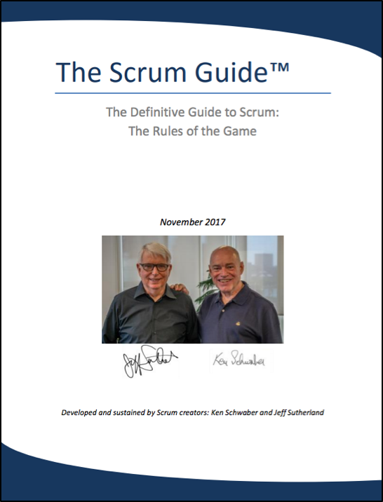
SCRUM GUIDE (November, 2020)
Officially, the Scrum Guide is the Scrum rulebook maintained by Ken Schwaber and Jeff Sutherland.
Please download your copy here and go through it
https://www.scrumguides.org/docs/scrumguide/v2020/2020-Scrum-Guide-US.pdf

Slide 77
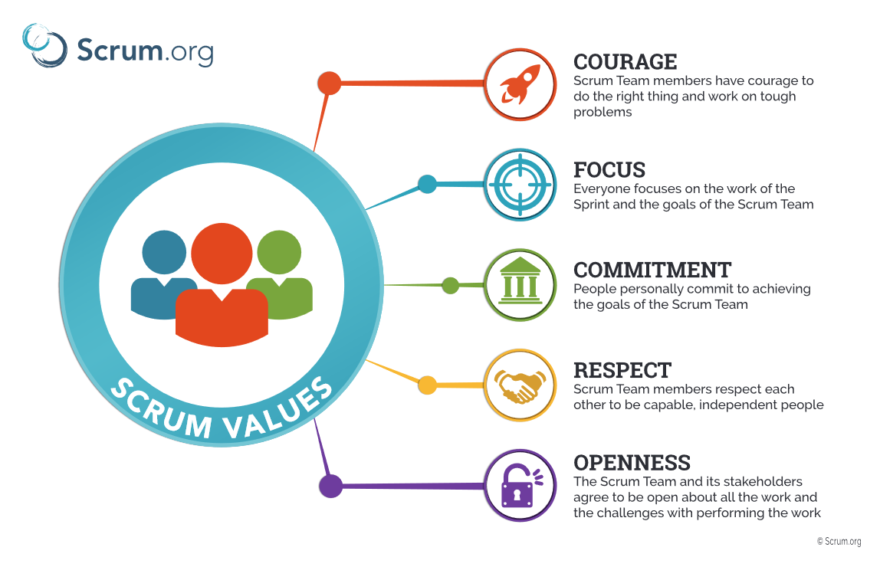
SCRUM VALUES
Successful use of Scrum depends on people becoming more proficient in living five values:
Courage
Focus
Commitment
Respect
Openness
Source: Scrum.org
Notes:
Scrum Values
Successful use of Scrum depends on people becoming more proficient in living five values:
Commitment, Focus, Openness, Respect, and Courage
The Scrum Team commits to achieving its goals and to supporting each other. Their primary focus is on the work of the Sprint to make the best possible progress toward these goals. The Scrum Team and its stakeholders are open about the work and the challenges. Scrum Team members respect each other to be capable, independent people, and are respected as such by the people with whom they work. The Scrum Team members have the courage to do the right thing, to work on tough problems.
These values give direction to the Scrum Team with regard to their work, actions, and behavior. The decisions that are made, the steps taken, and the way Scrum is used should reinforce these values, not diminish or undermine them. The Scrum Team members learn and explore the values as they work with the Scrum events and artifacts. When these values are embodied by the Scrum Team and the people they work with, the empirical Scrum pillars of transparency, inspection, and adaptation come to life building trust.

Slide 78
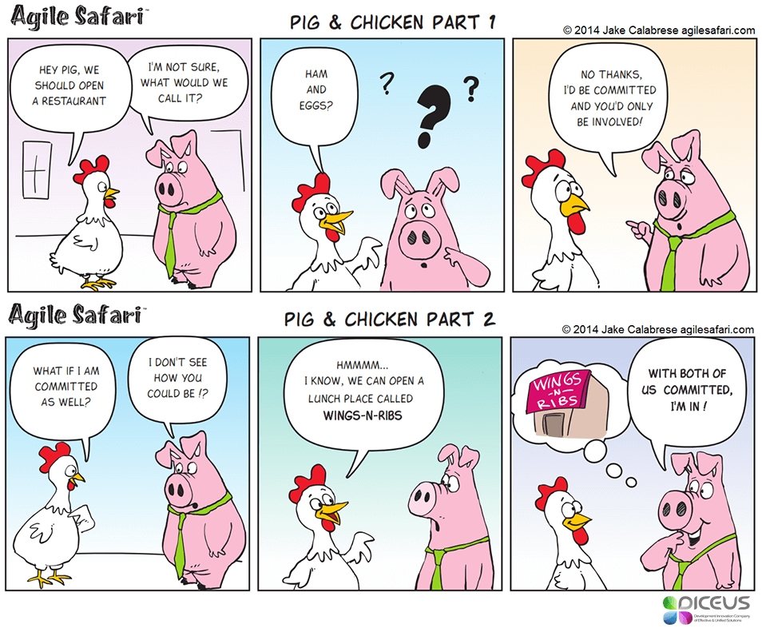
PIG AND CHICKEN (Involvement versus Commitment)
Notes:
Scrum Values
Successful use of Scrum depends on people becoming more proficient in living five values:
Commitment, Focus, Openness, Respect, and Courage
The Scrum Team commits to achieving its goals and to supporting each other. Their primary focus is on the work of the Sprint to make the best possible progress toward these goals. The Scrum Team and its stakeholders are open about the work and the challenges. Scrum Team members respect each other to be capable, independent people, and are respected as such by the people with whom they work. The Scrum Team members have the courage to do the right thing, to work on tough problems.
These values give direction to the Scrum Team with regard to their work, actions, and behavior. The decisions that are made, the steps taken, and the way Scrum is used should reinforce these values, not diminish or undermine them. The Scrum Team members learn and explore the values as they work with the Scrum events and artifacts. When these values are embodied by the Scrum Team and the people they work with, the empirical Scrum pillars of transparency, inspection, and adaptation come to life building trust.

Slide 79
SCRUM RULES
You Have No Hierarchical Role; You Are an Expert
You are Part of the Team
The Team’s Goals are your Goals; You committed to them
Do Whatever you can for the Team to meet its Goals –Forget Role Thinking!
There Is No Individual Failure – The Team Fails!
There Is No Individual Success – The Team Succeeds!
Done is done; as a team you completed these activities
You let the team down if you’re late to meetings

Slide 80
SCRUM BENEFITS
Team
The teams get focused > One common goal
Creates self discipline, accountability & responsibility
Faster, better Communication without barriers
No Manager-subordinate relationship – flat structure
Team Work, Commitment and Time & Risk Management
There Is No Individual Failure – The Team Fails!
There is No Individual Success –Team Success ( No man of the match)!
Stakeholders
Higher Visibility any time
Ability to respond and Adapt
Real software code in early phase of development life cycle
Better evaluation, testing, demonstration purposes.
Organization
Business Value - ROI

Slide 81
 | PRODUCT VISION
 | PRODUCT OWNER
A. | PRODUCT BACKLOG
C. | PRODUCT INCREMENT
 | SPRINT
 | SCRUM MASTER
 | DEVELOPMENT TEAM
1. | SPRINT PLANNING
 | SPRINT GOAL
B. | SPRINT BACKLOG
2. | DAILY SCRUM /STAND UP
 | BURNDOWN CHART
C. | PRODUCT INCREMENT
3. | SPRINT REVIEW
4. | SPRINT RETROSPECTIVE

Slide 82

PRODUCT VISION (now officially GOAL)
Product vision is a short statement which describes end goals, objectives and benefits of the product
Product vision is needed to ensure the product is moving in the right direction, strategies are aligned and that the development team spends its time creating the right product.
Product vision is owned by Product owner.
TRY! Elevator pitch:
“Can you explain your product in the time it takes to ride up in an elevator?”
...Passing this test ensures that your product vision is clear, engaging, and brief.

Slide 83

PRODUCT GOAL ( is a commitment for the Product Backlog)
Product Goal: The Product Goal describes a future state of the product which can serve as a target for the Scrum Team to plan against
Product Goal is a commitment for the Product Backlog
Context to the Product Backlog. ’Why' we are doing all of this work.
'what is the Scrum Team working on?
The Product Goal is in the Product Backlog. The rest of the Product Backlog emerges to define “what” will fulfill the Product Goal. = Minimal Product Backlog
Ex.: We commit to building an accessible and internationalized purchasing platform with advanced inventory management capabilities.
Notes:
Product Goal: The Product Goal describes a future state of the product which can serve as a target for the Scrum Team to plan against. The Product Goal is in the Product Backlog. The rest of the Product Backlog emerges to define “what” will fulfill the Product Goal.

Slide 84
PRODUCT VISION – MOOR’s MODEL
MOOR’s MODEL:
FOR: «target customer»
WHO: «needs»
THE: «product name»
IS A: «product category»
THAT: «product benefit. Reason to buy»
UNLIKE: «competitors»
OUR PRODUCT: «differentiation or value proposition».
EXAMPLE:
FOR a mid-sized company's marketing and sales departments
WHO need basic CRM functionality,
THE CRM-Innovator
IS A web-based service
THAT provides sales tracking, lead generation, and sales representative support features that improve customer relationships at critical touch points.
UNLIKE other services or package software products,
OUR PRODUCT provides very capable services at a moderate cost

Slide 85
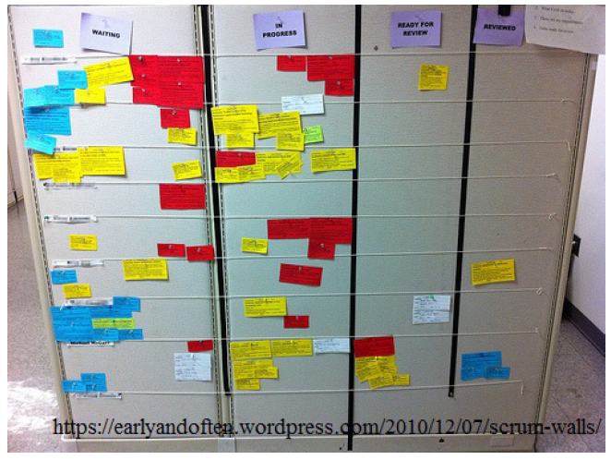
What is User Story?
The 3C:
Card
Conversation
Confirmation (~Acceptance Test)

Slide 86
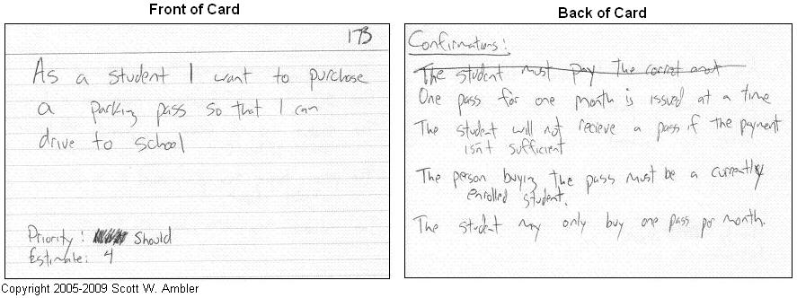
What is User Story?
The 3C:
Card : tangible and durable form otherwise only an abstraction
Conversation : a “conversation” taking place at different time and places during a project between the various people concerned by a given feature of a software product: customers, users, developers, testers, …
Confirmation (~Acceptance Test): objectives the conversation revolved around have been reached.

Slide 87
USER STORY
User story formats:
[Beginner] –
Simple statement of functionality which needs to be build. example: ‘View email history.’
[Classic] –
As a <user role>, I want <goal/desire> so that <benefit>. example: ‘As a senior support agent I want to view the emails send to the customer, so I know which communication took place.’
[Advanced] –
In order to <receive benefit> as a <user role> I want <goal/desire>. example: ‘In order to be able to assist customer promptly, as a senior support agent I want to view previous customer email communication on my agent dashboard.’
User story is an agile technique to facilitate requirement management.
Usual format:
As a <user role>,
I want <goal/desire>
so that <benefit>

Slide 88




User Story Templates
User Stories are written by following a template.
Generic Structure: As [WHO], I want [WHAT], so that [WHY]
User story templates proposed by Mike Cohn:
I as a <role>,
I want <function>,
so that <business value>.
As a creator,
I want to upload a video,
so that any users can view it.
As a <type of user>,
I want <capability> ,
so that <business value>.
As a book buyer,
I want to search for a book by ISBN,
so that I can find the right book quickly.
As a <type of user>,
I want <some goal>,
so that <some reason>.
As a user,
I can indicate folders not to backup,
so that my backup drive isn't filled up
with things I don't need saved.

Slide 89
USER STORY - EXAMPLES
As a registered user,
I want to purchase XYZ products online
so that I do not have to go to the store.
As a purchaser,
I want to search for generic equivalents of brand named items
so I can save money.
As a purchaser,
I want to get a receipt for a past transaction
so that I can keep my own off-line records.
As a vendor,
I want to see monthly sales reports
so I can see which products are selling best.

Slide 90
USER STORY - A GOOD ONE!
INVEST
A good user story is:
Independent / immediately actionable - ideally can be implemented in any order
Negotiable - and negotiated
Valuable - to the customer
Estimatable - enough to rank and schedule it
Small - and with short descriptions
Testable - I could write a test for it

Slide 91
ACCEPTANCE CRITERIA
Acceptance criteria—checklist which defines acceptance testing for a particular story
Acceptance criteria formats:
[Beginner] –
Simple description on how functionality should work.
Example: ‘Only show last 2 emails sent to the customer’ ‘When pressing “resend email”, show example of email sent’
[Advanced] –
Given <precondition> When <scenario> Then <expected result>.
Example: ‘Given that customer didn’t receive any emails yet, when agent opens dashboard, then ‘no previous emails’ message is displayed.’
User story
Acceptance criteria

Slide 92
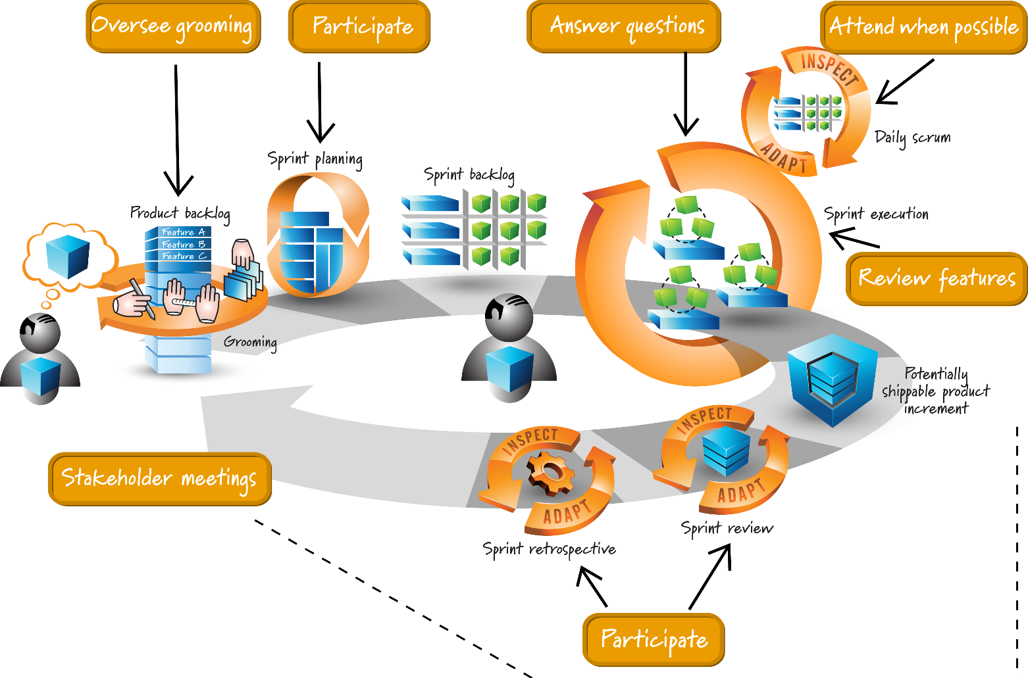
PRODUCT OWNER (PO)
The Product Owner is accountable for maximizing the value of the product resulting from the work of the Scrum Team.
PO represents the interests of stakeholders, sets priorities, manages the Product backlog and is accountable for effective Product Backlog management i.e.
elicits product requirements
creates & prioritizes Product backlog
manages Releases
describes features to the Development team
accepts or rejects work results
Notes:
Product Owner
The Product Owner is accountable for maximizing the value of the product resulting from the work of the Scrum Team. How this is done may vary widely across organizations, Scrum Teams, and individuals.
The Product Owner is also accountable for effective Product Backlog management, which includes:
Developing and explicitly communicating the Product Goal;
Creating and clearly communicating Product Backlog items;
Ordering Product Backlog items; and,
Ensuring that the Product Backlog is transparent, visible and understood.
The Product Owner may do the above work or may delegate the responsibility to others. Regardless, the Product Owner remains accountable.
For Product Owners to succeed, the entire organization must respect their decisions. These decisions are visible in the content and ordering of the Product Backlog, and through the inspectable Increment at the Sprint Review.
The Product Owner is one person, not a committee. The Product Owner may represent the needs of many stakeholders in the Product Backlog. Those wanting to change the Product Backlog can do so by trying to convince the Product Owner.

Slide 93
A PRODUCT BACKLOG
The Product Backlog is an emergent, ordered list of what is needed to improve the product. It is the single source of work undertaken by the Scrum Team.
Product backlog...
Contains features, defects, technical work, knowledge acquisition
Ordered by priority
Prioritised by product owner with help from the development team and stakeholders
Product Backlog is owned & prioritized by Product Owner - Those wanting to change the Product Backlog can do so by trying to convince the Product Owner.
Feature A (FA)
Feature B (FB) Feature C (FC)
Notes:
Product Backlog: A Scrum Artifact that consists of an ordered list of the work to be done in order to create, maintain and sustain a product. Managed by the Product Owner.
Product Backlog
The Product Backlog is an emergent, ordered list of what is needed to improve the product. It is the single source of work undertaken by the Scrum Team.
Product Backlog items that can be Done by the Scrum Team within one Sprint are deemed ready for selection in a Sprint Planning event. They usually acquire this degree of transparency after refining activities. Product Backlog refinement is the act of breaking down and further defining Product Backlog items into smaller more precise items. This is an ongoing activity to add details, such as a description, order, and size. Attributes often vary with the domain of work.
The Developers who will be doing the work are responsible for the sizing. The Product Owner may influence the Developers by helping them understand and select trade-offs.
Commitment: Product Goal
The Product Goal describes a future state of the product which can serve as a target for the Scrum Team to plan against. The Product Goal is in the Product Backlog. The rest of the Product Backlog emerges to define “what” will fulfill the Product Goal.
A product is a vehicle to deliver value. It has a clear boundary, known stakeholders, well-defined users or customers. A product could be a service, a physical product, or something more abstract.
The Product Goal is the long-term objective for the Scrum Team. They must fulfill (or abandon) one objective before taking on the next.

Slide 94

A PRODUCT BACKLOG - PRIORITIZATION
Prioritization techniques: MoSCow, Kano, Buy-a-feature, the Product tree etc.
Example: MOSCoW Prioritization:
Must have — all “must have” stories form the minimal viable product (MVP) and good enough for the first release
Should have — all “should have” stories make this product competitive
Could Have — all “could have” stories delight the customer
Won’t Have — all “won’t have” stories aren’t worth doing. The majority of stories (65%) should fall into the “won’t have” pile
Feature A (FA)
Feature B (FB) Feature C (FC)

Slide 95
PRODUCT BACKLOG - EXAMPLE
Product Backlog
As a guest, I want to make a reservation.
As a guest, I want to cancel a reservation.
As a guest, I want to change the dates of reservation.
As a hotel employee, I want to see room availability.
Investigate solution for speeding up credit card validation.
Diagnose and fix booking processing script errors.
Feature A (FA)
Feature B (FB) Feature C (FC)

Slide 96
BETAS...
“Never do betas.
Never do work that you don’t think is good. You either give your customer something good, or you don’t. There is no ‘try’.”
― Jeff Sutherland

Slide 97
C INCREMENT – “VERSION OF THE PRODUCT”
The Increment is the sum of all the Product Backlog items completed during a Sprint and the value of the increments of all previous Sprints. At the end of a Sprint, the new Increment must be "Done" – i.e. in useable condition and meet the Definition of Done (DoD).
*Sum of all Increments - as a whole - form a product.
Notes:
Increment: Scrum Artifact that defines the complete and valuable work produced by the Development Team during a Sprint. The sum of all Increments form a product.

Slide 98
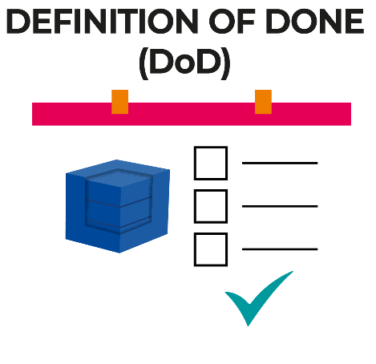
DEFINITION OF DONE (DoD)
Definition of Done: a shared understanding of expectations that the Increment must live up to in order to be releasable into production.
DoD is unique per team.
DoD is managed by the Development Team.
DoD may change over time as the team learn from the process.
DoD is reviewed by the development team at sprint retrospective or sprint planning.
User story 1
User story 1
Not Done
User story 2
User story 2
Done
User story x
User story x
Done
Definition of Done vs. Acceptance Criteria:
Definition of done is generic and applicable to all stories.
Acceptance criteria is specific and is different for different user stories
Notes:
Definition of Done: a shared understanding of expectations that the Increment must live up to in order to be releasable into production. Managed by the Development Team.

Slide 99

DEFINITION OF DONE (DoD) - EXAMPLE
Example Definition of Done (DoD):
All development has been completed
Functionality has been tested by developer
Unit tests have been completed
New business functionality satisfies acceptance criteria in Websphere*
All features have been tested in IE8** and IE9**
Regression tested in IE8** & IE9** test environment
Code has been reviewed by another developer
Story has been reviewed by product owner, and product owner has accepted all open issues, if any

Slide 100
DEFINITION OF DONE is a commitment for Increment
Definition of Done is a commitment* for the Increment
* Each artifact contains a commitment to ensure it provides information that enhances transparency and focus against which progress can be measured

Slide 101
 | PRODUCT VISION
 | PRODUCT OWNER
A. | PRODUCT BACKLOG
C. | PRODUCT INCREMENT
 | SPRINT
 | SCRUM MASTER
 | DEVELOPMENT TEAM
1. | SPRINT PLANNING
 | SPRINT GOAL
B. | SPRINT BACKLOG
2. | DAILY SCRUM /STAND UP
 | BURNDOWN CHART
C. | PRODUCT INCREMENT
3. | SPRINT REVIEW
4. | SPRINT RETROSPECTIVE

Slide 102
“At its root, Scrum is based on a simple idea: whenever you start a project, why not regularly check in, see if what you’re doing is heading in the right direction, and if it’s actually what people want?
And question whether there are any ways to improve how you’re doing what you’re doing, any ways of doing it better and faster, and what might be keeping you from doing that.”
― Jeff Sutherland

Slide 103
SPRINT
The Sprint is a container for all other events.
Sprint is a time-box of one month or less during which a "Done", useable, and potentially releasable product Increment is created.

Slide 104

SPRINT
Sprint is a time-boxed event with a goal of producing working product at the end of it
Sprint length: 1-4 Weeks
Sprint Events are:
Sprint planning
Daily scrum (standup)
Backlog refinement (grooming)
Sprint review
Sprint retrospective
Best practice for sprints:
Consistent duration throughout life cycle of the project
New sprint starts immediately after the conclusion of the previous sprint
Schedule recurring meetings for all scrum events in team diaries
Create sprint goals for each sprint
Iteration: Often sprints are called iterations. Iteration and sprint are the same concept.
Notes:
The Sprint
Sprints are the heartbeat of Scrum, where ideas are turned into value.
They are fixed length events of one month or less to create consistency. A new Sprint starts immediately after the conclusion of the previous Sprint.
All the work necessary to achieve the Product Goal, including Sprint Planning, Daily Scrums, Sprint Review, and Sprint Retrospective, happen within Sprints.
During the Sprint:
No changes are made that would endanger the Sprint Goal;
Quality does not decrease;
The Product Backlog is refined as needed; and,
Scope may be clarified and renegotiated with the Product Owner as more is learned.
Sprints enable predictability by ensuring inspection and adaptation of progress toward a Product Goal at least every calendar month. When a Sprint’s horizon is too long the Sprint Goal may become invalid, complexity may rise, and risk may increase. Shorter Sprints can be employed to generate more learning cycles and limit risk of cost and effort to a smaller time frame. Each Sprint may be considered a short project.
Various practices exist to forecast progress, like burn-downs, burn-ups, or cumulative flows. While proven useful, these do not replace the importance of empiricism. In complex environments, what will happen is unknown. Only what has already happened may be used for forward-looking decision making.
A Sprint could be cancelled if the Sprint Goal becomes obsolete. Only the Product Owner has the authority to cancel the Sprint.

Slide 105
“Scrum doesn’t have project managers. Instead, the team is empowered. They’re responsible for the outcome, and they can manage themselves.
The classic project manager ‘boss’ of the team isn’t needed in Scrum. The team plans each Sprint based on the priorities of the Product Owner. They divide the work among themselves, make progress transparent and monitor themselves.”
― Jeff Sutherland

Slide 106
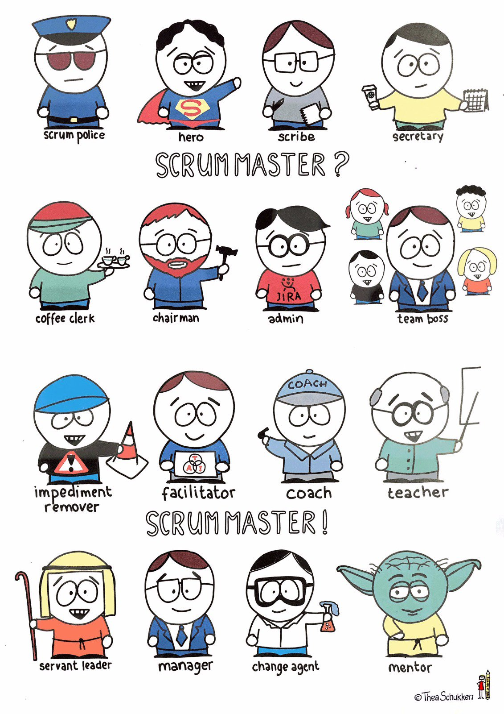
SCRUM MASTER (SM)
SM is responsible for ensuring Scrum is understood and enacted. The SM is a servant-leader for the Scrum Team and ensures that the team adheres to Scrum theory, practices, and rules i.e.
manages the Scrum process
ensures team follows scrum values & rules
ensures that the team is fully functional and productive
removes impediments
Can product owner and scrum master be the same person?
No. The roles have different goals and responsibilities. Product owner protects interests of stakeholders and scrum master protects interests of their development team. Often they „play offense-defense”, which is not possible to achieve when one person combines both roles.
Notes:
Scrum Master
The Scrum Master is accountable for establishing Scrum as defined in the Scrum Guide. They do this by helping everyone understand Scrum theory and practice, both within the Scrum Team and the organization.
The Scrum Master is accountable for the Scrum Team’s effectiveness. They do this by enabling the
Scrum Team to improve its practices, within the Scrum framework.
Scrum Masters are true leaders who serve the Scrum Team and the larger organization. The Scrum Master serves the Scrum Team in several ways, including:
Coaching the team members in self-management and cross-functionality;
Helping the Scrum Team focus on creating high-value Increments that meet the Definition of Done;
Causing the removal of impediments to the Scrum Team’s progress; and,
Ensuring that all Scrum events take place and are positive, productive, and kept within the timebox.
The Scrum Master serves the Product Owner in several ways, including:
Helping find techniques for effective Product Goal definition and Product Backlog management;
Helping the Scrum Team understand the need for clear and concise Product Backlog items;
Helping establish empirical product planning for a complex environment; and,
Facilitating stakeholder collaboration as requested or needed.
The Scrum Master serves the organization in several ways, including:
Leading, training, and coaching the organization in its Scrum adoption;
Planning and advising Scrum implementations within the organization;
Helping employees and stakeholders understand and enact an empirical approach for complex work; and,
Removing barriers between stakeholders and Scrum Teams.

Slide 107
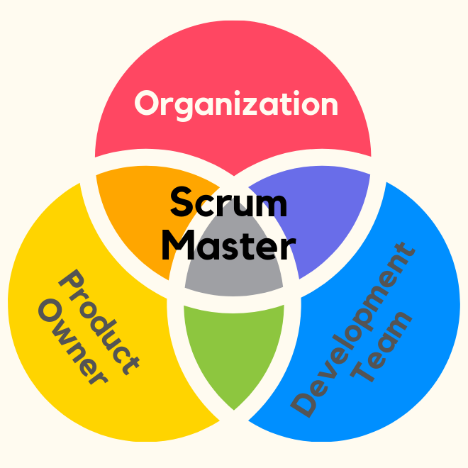
SCRUM MASTER (SM)
The Scrum Master serves the Scrum Team in several ways, including:
Coaching the team members in self-management and cross-functionality;
Helping the Scrum Team focus on creating high-value Increments that meet the Definition of Done;
Causing the removal of impediments to the Scrum Team’s progress; and,
Ensuring that all Scrum events take place and are positive, productive, and kept within the timebox.
The Scrum Master serves the Product Owner in several ways, including:
Helping find techniques for effective Product Goal definition and Product Backlog management;
Helping the Scrum Team understand the need for clear and concise Product Backlog items;
Helping establish empirical product planning for a complex environment; and,
Facilitating stakeholder collaboration as requested or needed.
The Scrum Master serves the organization in several ways, including:
Leading, training, and coaching the organization in its Scrum adoption;
Planning and advising Scrum implementations within the organization;
Helping employees and stakeholders understand and enact an empirical approach for complex work; and,
Removing barriers between stakeholders and Scrum Teams.
Source: Scrum Guide
Notes:
Scrum Master
The Scrum Master is accountable for establishing Scrum as defined in the Scrum Guide. They do this by helping everyone understand Scrum theory and practice, both within the Scrum Team and the organization.
The Scrum Master is accountable for the Scrum Team’s effectiveness. They do this by enabling the
Scrum Team to improve its practices, within the Scrum framework.
Scrum Masters are true leaders who serve the Scrum Team and the larger organization. The Scrum Master serves the Scrum Team in several ways, including:
Coaching the team members in self-management and cross-functionality;
Helping the Scrum Team focus on creating high-value Increments that meet the Definition of Done;
Causing the removal of impediments to the Scrum Team’s progress; and,
Ensuring that all Scrum events take place and are positive, productive, and kept within the timebox.
The Scrum Master serves the Product Owner in several ways, including:
Helping find techniques for effective Product Goal definition and Product Backlog management;
Helping the Scrum Team understand the need for clear and concise Product Backlog items;
Helping establish empirical product planning for a complex environment; and,
Facilitating stakeholder collaboration as requested or needed.
The Scrum Master serves the organization in several ways, including:
Leading, training, and coaching the organization in its Scrum adoption;
Planning and advising Scrum implementations within the organization;
Helping employees and stakeholders understand and enact an empirical approach for complex work; and,
Removing barriers between stakeholders and Scrum Teams.

Slide 108
“It’s better that a project manager not become the Scrum Master of his project....
When a former project manager steps into that role, there’s a fair chance that everyone will fall back into their old patterns. The developers will expect him to solve all their problems, and he’ll feel obligated to do so.”
― Jeff Sutherland

Slide 109
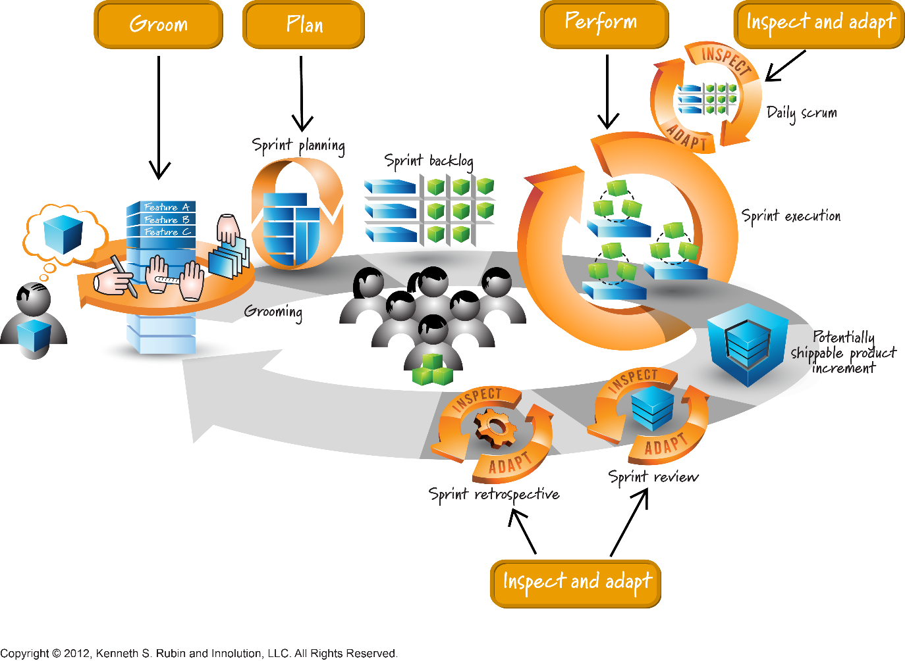
DEVELOPMENT TEAM (DT)
Developers are the people in the Scrum Team that are committed to creating any aspect of a usable Increment each Sprint.
Development team is responsible for estimating and implementing features i.e.
estimates size of Sprint backlog items (e.g. Planning Poker)
tracks work progress every day (Daily Scrum Meeting)
turns Sprint backlog list into Potentially shippable product increment and demonstrates it to PO
* It is not preferable to have fewer than three and more than ten team members.
Notes:
Developers
Developers are the people in the Scrum Team that are committed to creating any aspect of a usable Increment each Sprint.
The specific skills needed by the Developers are often broad and will vary with the domain of work. However, the Developers are always accountable for:
Creating a plan for the Sprint, the Sprint Backlog;
Instilling quality by adhering to a Definition of Done;
Adapting their plan each day toward the Sprint Goal; and,
Holding each other accountable as professionals.

Slide 110
 | PRODUCT VISION
 | PRODUCT OWNER
A. | PRODUCT BACKLOG
C. | PRODUCT INCREMENT
 | SPRINT
 | SCRUM MASTER
 | DEVELOPMENT TEAM
1. | SPRINT PLANNING
 | SPRINT GOAL
B. | SPRINT BACKLOG
2. | DAILY SCRUM /STAND UP
 | BURNDOWN CHART
C. | PRODUCT INCREMENT
3. | SPRINT REVIEW
4. | SPRINT RETROSPECTIVE
Notes:
Sprint Planning
Sprint Planning initiates the Sprint by laying out the work to be performed for the Sprint. This resulting plan is created by the collaborative work of the entire Scrum Team.
The Product Owner ensures that attendees are prepared to discuss the most important Product Backlog items and how they map to the Product Goal. The Scrum Team may also invite other people to attend Sprint Planning to provide advice.
Sprint Planning addresses the following topics:
Topic One: Why is this Sprint valuable?
The Product Owner proposes how the product could increase its value and utility in the current Sprint. The whole Scrum Team then collaborates to define a Sprint Goal that communicates why the Sprint is valuable to stakeholders. The Sprint Goal must be finalized prior to the end of Sprint Planning.
Topic Two: What can be Done this Sprint?
Through discussion with the Product Owner, the Developers select items from the Product Backlog to include in the current Sprint. The Scrum Team may refine these items during this process, which increases understanding and confidence.
Selecting how much can be completed within a Sprint may be challenging. However, the more the Developers know about their past performance, their upcoming capacity, and their Definition of Done, the more confident they will be in their Sprint forecasts.
Topic Three: How will the chosen work get done?
For each selected Product Backlog item, the Developers plan the work necessary to create an Increment that meets the Definition of Done. This is often done by decomposing Product Backlog items into smaller work items of one day or less. How this is done is at the sole discretion of the Developers. No one else tells them how to turn Product Backlog items into Increments of value.
The Sprint Goal, the Product Backlog items selected for the Sprint, plus the plan for delivering them are together referred to as the Sprint Backlog.
Sprint Planning is timeboxed to a maximum of eight hours for a one-month Sprint. For shorter Sprints, the event is usually shorter.

Slide 111
RELATIVE ESTIMATION
Relative estimation is a forecasting technique with a story point as a unit of measure
Use Modified Fibonacci’s numbers:
Scale is 1 2 3 5 8 13 20 40 100
Why story points?...and not time
Estimation in relative points has proven to be quicker. Also estimation in hours is prone to further inaccuracies because it is based on ideal hours.
Estimation in relative points has proven to be quicker
It removes link between estimating effort and committing to timelines
It helps to remove false accuracy around estimates
1
2
3
5
8
13
20
40
100
...

Slide 112
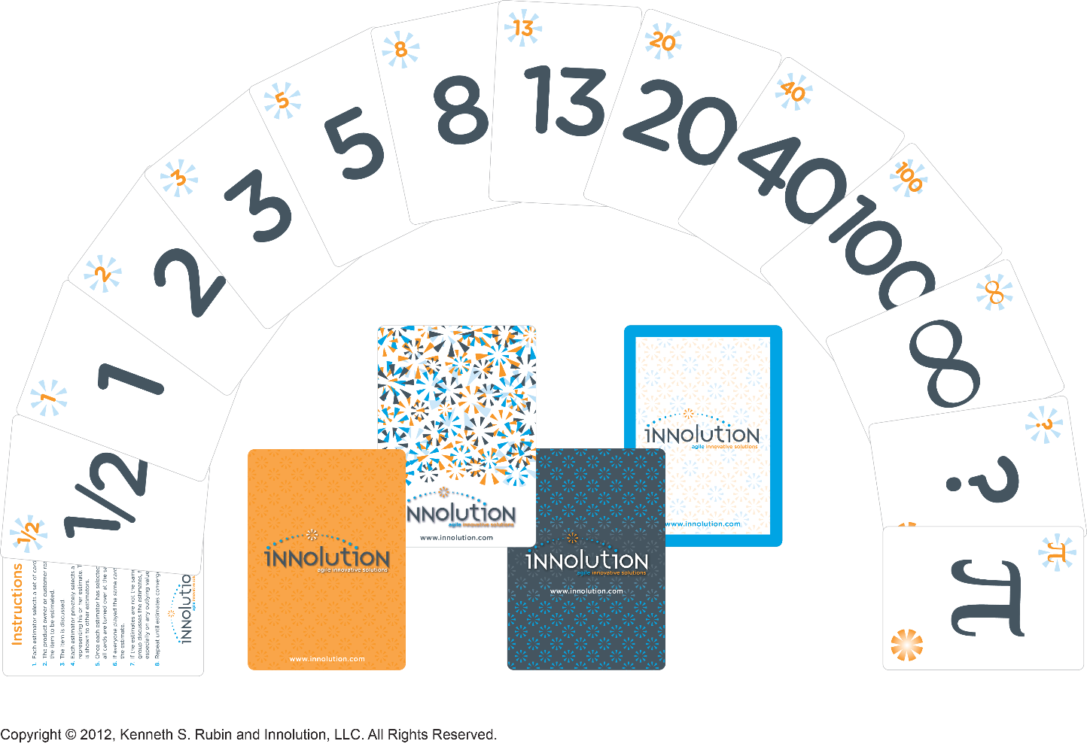
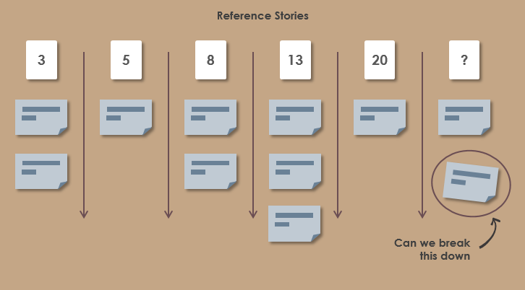
Story Point: Planning Poker Fibonacci number (1, 2, 3, 5, 8, 13, 21, 34, …)
Estimating stories: “will this take longer than reference story x?” or “will it be less than reference y?

Slide 113
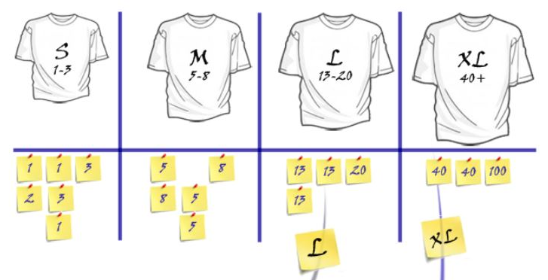
RELATIVE ESTIMATION – PLANNING POKER
Planning poker is a consensus-based technique for estimation. It helps avoiding the influence of the other participants.
Summary:
Define a reference story, assign a value
Everybody gets a set of „Planning poker cards”
Discuss a story
Pull up the cards at the same time
Discuss
The procedure:
User story is selected
Product owner (or scrum master) briefly explains the story and answers any related questions (2mins)
Voting occurs (1st round)
If the estimates show a large variation, a further 2 mins should be used to explain why the estimates should be higher or lower
Voting occurs (2nd round)
If the estimates still show a large variation, a further 2 mins should be used to re-explain/justify the estimates
Voting occurs (3rd round)
If, after the 3rd round of voting, no consensus can be reached regarding the size, the story is placed on hold

Slide 114


1 SPRINT PLANNING

Slide 115
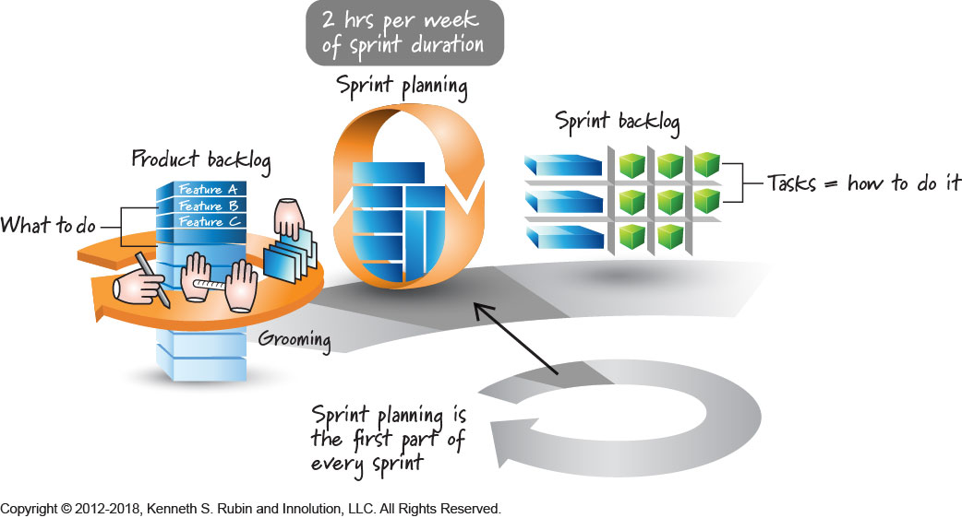
1 SPRINT PLANNING
When: First day of each sprint
Duration: 2 hours for every week of sprint
Who: Scrum Team (optional: stakeholders)
Sprint Planning is a two part meeting to plan work for the sprint and answers the following:
WHAT can be delivered in the Increment resulting from the upcoming Sprint? (Product Owner presents the User stories)
HOW will the work needed to deliver the Increment be achieved? (Team breaks down the User stories in Tasks to fill the Sprint Backlog)
Notes:
Sprint Planning: Scrum Event that is time-boxed to 8 hours, or less, to start a Sprint. It serves for the Scrum Team to inspect the work from the Product Backlog that’s most valuable to be done next and design that work into Sprint backlog

Slide 116

1 SPRINT PLANNING - AGENDA
Agenda
WHAT Creating Sprint Backlog Determining the Sprint Goal. Participants: Scrum Team | HOW Participants: Scrum Master, Development Team Creating Sprint Backlog
Discuss team capacity Identify sprint goal Identify user stories needed to achieve sprint goal Clarify requirements for these user stories Update product backlog: split, delete, combine, move stories Estimate user stories Commit to sprint goal and user stories | Decide how to achieve the sprint goal (design) Clarify requirements further Negotiate trade-offs Break down stories into tasks Update Scrum board

Slide 117
B SPRINT BACKLOG
Sprint Backlog: Scrum Artifact that provides an overview of the development work to realize a Sprint’s goal, typically a forecast of functionality and the work needed to deliver that functionality.
... Managed by the Development Team
... List of user stories, tasks and other activities team commits to deliver in order to achieve sprint goal
FA FA points
FB FB points
FC FC points
Notes:
Sprint Backlog: Scrum Artifact that provides an overview of the development work to realize a Sprint’s goal, typically a forecast of functionality and the work needed to deliver that functionality. Managed by the Development Team

Slide 118
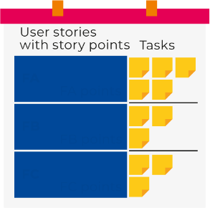
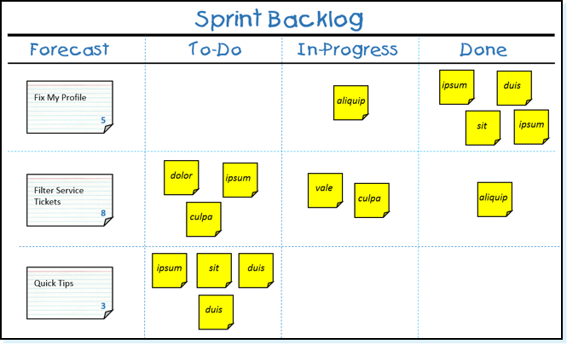
B SPRINT BACKLOG
Sprint backlog is a list of user stories, tasks and other activities team commits to deliver in order to achieve sprint goal. The sprint backlog comes from the product backlog, but it contains only items, that can be completed during respective sprint.
It is common practice in Scrum that the Sprint Backlog is represented on a Scrum board or task board, which provides a constantly visible depiction of the status of the User Stories in the backlog.
Features are selected from Product Backlog by Development team on the basis of their priorities
The features which are planned to be implemented in Sprint are selected
No features can be added during Sprint
Notes:
Sprint Backlog
The Sprint Backlog is composed of the Sprint Goal (why), the set of Product Backlog items selected for the Sprint (what), as well as an actionable plan for delivering the Increment (how).
The Sprint Backlog is a plan by and for the Developers. It is a highly visible, real-time picture of the work that the Developers plan to accomplish during the Sprint in order to achieve the Sprint Goal.
Consequently, the Sprint Backlog is updated throughout the Sprint as more is learned. It should have enough detail that they can inspect their progress in the Daily Scrum.
Commitment: Sprint Goal
The Sprint Goal is the single objective for the Sprint. Although the Sprint Goal is a commitment by the Developers, it provides flexibility in terms of the exact work needed to achieve it. The Sprint Goal also creates coherence and focus, encouraging the Scrum Team to work together rather than on separate initiatives.
The Sprint Goal is created during the Sprint Planning event and then added to the Sprint Backlog. As the Developers work during the Sprint, they keep the Sprint Goal in mind. If the work turns out to be different than they expected, they collaborate with the Product Owner to negotiate the scope of the Sprint Backlog within the Sprint without affecting the Sprint Goal.

Slide 119
B SPRINT BACKLOG - EXAMPLE
Backlog items | Task
Enable all users to place book in shopping cart (28 points) | Design business logic (4 points)
 | Design user interface (2 points)
 | Implement back-end code (2 points)
 | Implement front-end code (6 points)
 | Complete documentation (8 points)
 | Unit testing (4 points)
 | Regression testing (2 points)
Upgrade transaction processing module (17 points) | Implement back-end code (5 points)
 | Complete documentation (6 points)
 | Unit testing (3 points)
 | Regresion testing (3 points)
 | TOTAL: 45 points

Slide 120
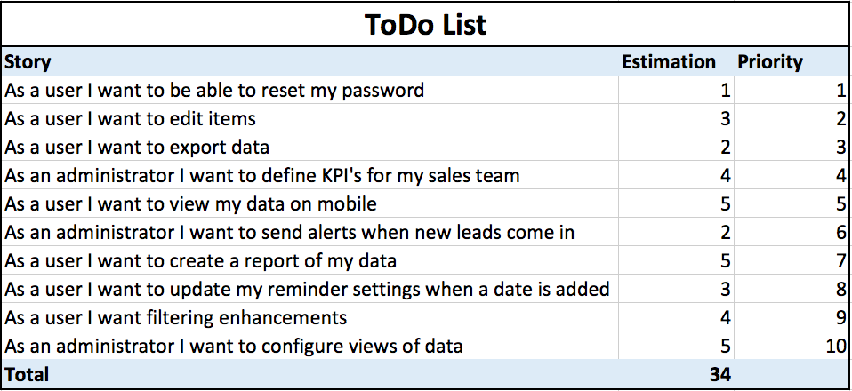
B SPRINT BACKLOG - EXAMPLE

Slide 121
B SPRINT BACKLOG – TIPS & TRICKS
Use different colours for different types of tasks (i.e. development—blue, impediments—purple, business analysis—pink), but each Development team can define their own standards at visualizing sprint backlog
Limit number of user stories in progress—it will reduce amount of user stories carried over into next sprints
Limit number of impediments in progress—focus on most serious blockers first
Agree on maximum period of time to resolve an impediment, before it is escalated to broader audience
Use index cards for user stories and post-it notes for tasks
A good user story can be done within 3 days and a good task should take no more than 1 day
Add your retrospective actions to sprint backlog as well

Slide 122
SPRINT GOAL is a commitment for Sprint backlog
Sprint Goal is a short (1-2 sentences) description of what the team plans to achieve during sprint
Whole scrum team decides on sprint goal together with stakeholders
Sprint goal must be realistic and SMART (specific, measurable, achievable, relevant and timely)
Sprint goal must not be forced onto the development team
Sprint goal is decided during sprint planning event
Notes:
Sprint Goal: a short expression of the purpose of a Sprint, often a business problem that is addressed. Functionality might be adjusted during the Sprint in order to achieve the Sprint Goal.

Slide 123
SPRINT GOAL is a commitment for Sprint backlog
Sprint Goal is a commitment* for the SprintBacklog
Example Sprint goals:
Example 1: In this sprint we will implement basic shopping cart functionality including add, remove and update features
Example 2: In this sprint we will integrate VISA payment gateway into our billing module and investigate MasterCard gateway

Slide 124
 | PRODUCT VISION
 | PRODUCT OWNER
A. | PRODUCT BACKLOG
C. | PRODUCT INCREMENT
 | SPRINT
 | SCRUM MASTER
 | DEVELOPMENT TEAM
1. | SPRINT PLANNING
 | SPRINT GOAL
B. | SPRINT BACKLOG
2. | DAILY SCRUM /STAND UP
 | BURNDOWN CHART
C. | PRODUCT INCREMENT
3. | SPRINT REVIEW
4. | SPRINT RETROSPECTIVE

Slide 125
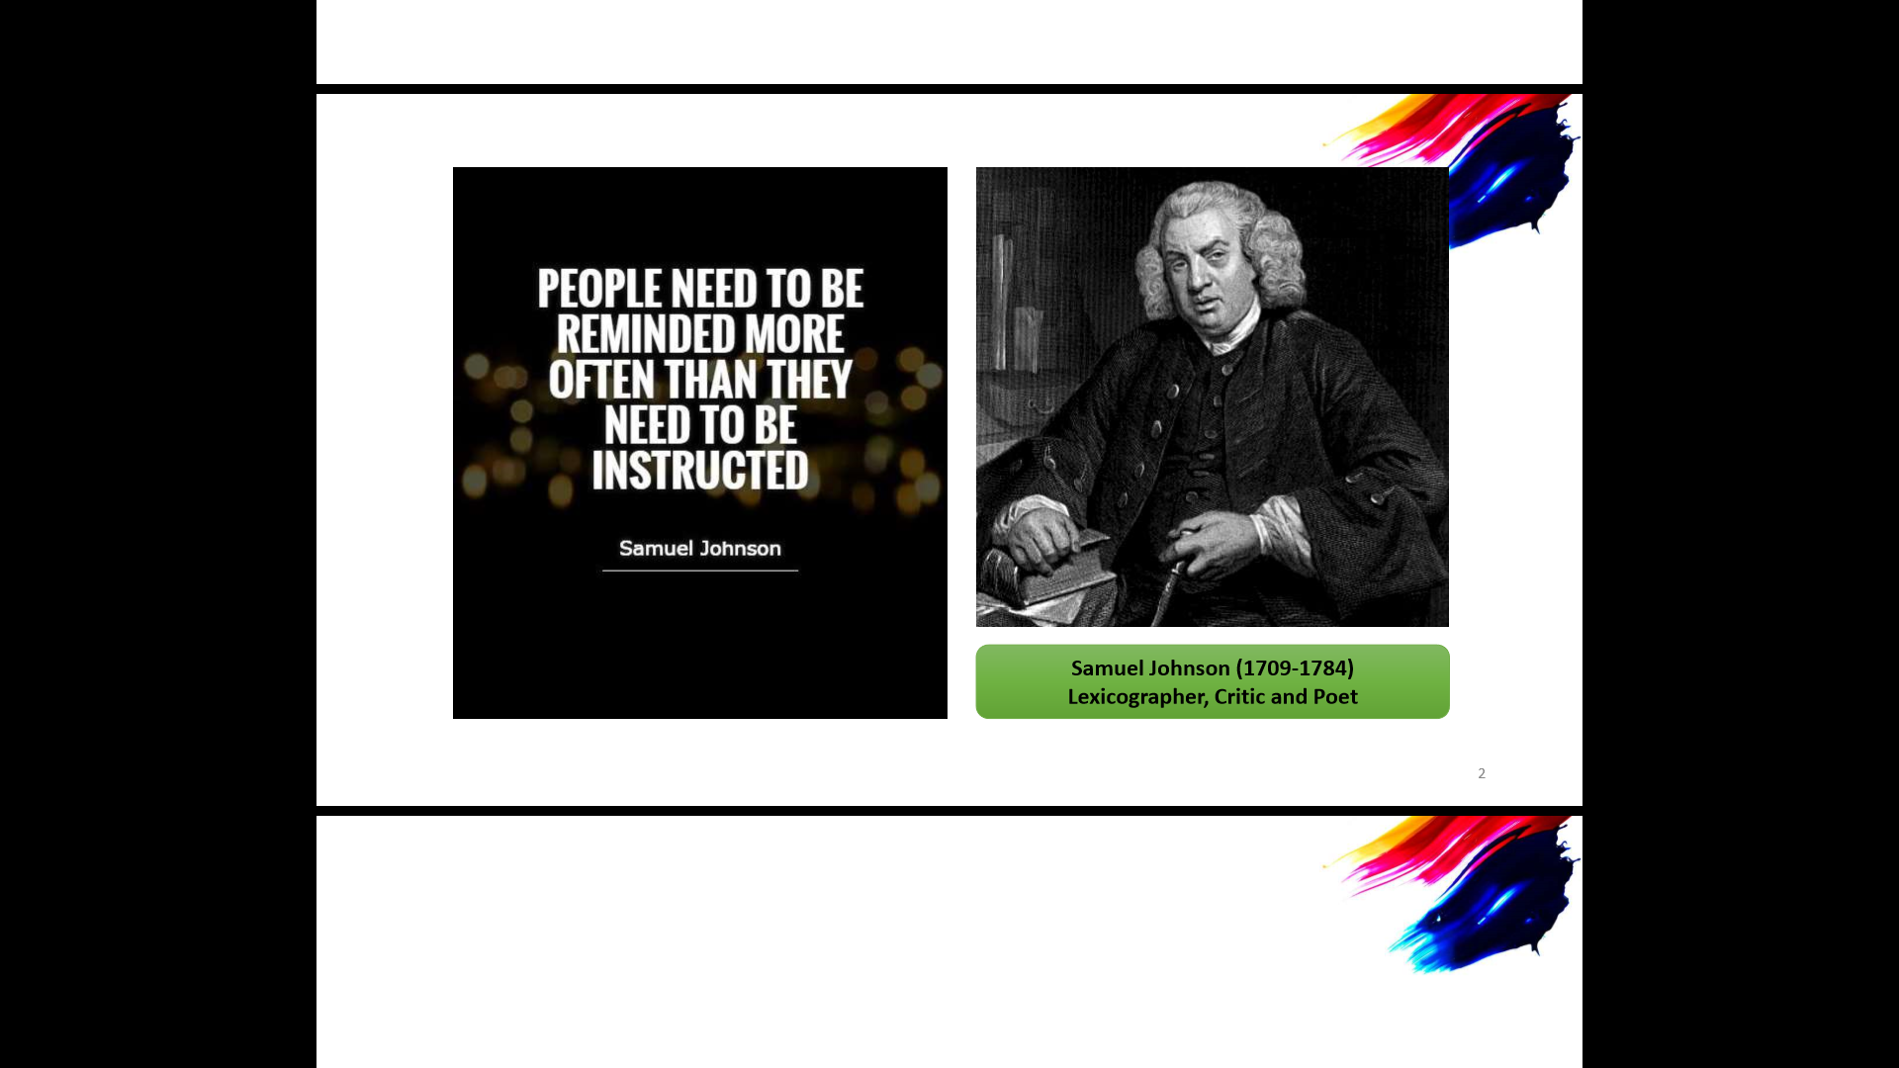
„People need to be reminded more often than they need to be instructed”
- Samuel Johnson

Slide 126
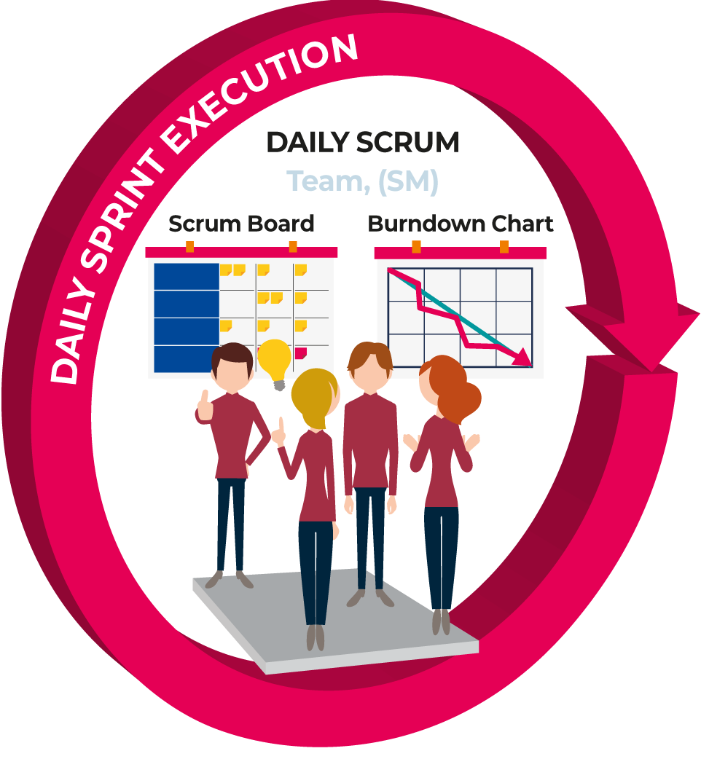
2 DAILY SCRUM

Slide 127

2 DAILY SCRUM / STAND UP
Daily Scrum is a commitment and coordination meeting to synchronise the development team and plan for the next 24hrs. It is designed to ensure that the entire development team is aware of impediments, what stories are done or not-done, and what tasks are ready to be pulled from one development team member's to-do list into someone else's.
At/ after standup:
Review impediments,
Update burndown chart,
Make decisions,
Update sprint backlog
When: Every day (same time, same place)
Duration: 15 min
Who: Development Team (optionally SM, PO, stakeholders)
Tip: „Parking lot”
If you feel that a conversation is going on for too long and other team members start to lose interest, you can add the issue to the parking lot and ask those involved to discuss it right after the standup.
Notes:
Daily Scrum: Scrum Event that is a 15-minute time-boxed event held each day for the Development Team. The Daily Scrum is held every day of the Sprint. At it, the Development Team plans work for the next 24 hours. This optimizes team collaboration and performance by inspecting the work since the last Daily Scrum and forecasting upcoming Sprint work. The Daily Scrum is held at the same time and place each day to reduce complexity.
Daily Scrum
The purpose of the Daily Scrum is to inspect progress toward the Sprint Goal and adapt the Sprint Backlog as necessary, adjusting the upcoming planned work.
The Daily Scrum is a 15-minute event for the Developers of the Scrum Team. To reduce complexity, it is held at the same time and place every working day of the Sprint. If the Product Owner or Scrum Master are actively working on items in the Sprint Backlog, they participate as Developers.
The Developers can select whatever structure and techniques they want, as long as their Daily Scrum focuses on progress toward the Sprint Goal and produces an actionable plan for the next day of work. This creates focus and improves self-management.
Daily Scrums improve communications, identify impediments, promote quick decision-making, and consequently eliminate the need for other meetings.
The Daily Scrum is not the only time Developers are allowed to adjust their plan. They often meet throughout the day for more detailed discussions about adapting or re-planning the rest of the Sprint’s work.

Slide 128
2 DAILY SCRUM / STAND UP
Agenda
Each development team member should answer these 3 questions: What did I do yesterday? What will I do today? What impediments prevent me/development team from meeting the sprint goal?

Slide 129
2 DAILY SCRUM / STAND UP
Why daily?
Q: “How does a project get to be a year late?”
A: „One day at a time.”
- Fred Brooks, The Mythical Man-Month.
Can Scrum meetings be replaced by emailed status reports?
NO! .... Meeting are important because...
... Entire developement team sees the whole picture every day
... It creates peer pressure to do what you say you’ll do

Slide 130
2 DAILY SCRUM / STAND UP – IS NOT
Is NOT a problem solving session
Is NOT a way to collect information about WHO is behind the schedule
Is a meeting in which Development team members make commitments to each other and to the Scrum Master
Is a good way for a Scrum Master to track the progress of the Development team

Slide 131
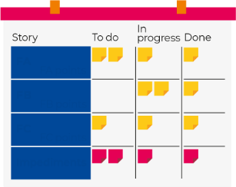
SCRUM BOARD (REPRESENTATION OF SPRINT BACKLOG)
Sprint backlog is represented on a scrum board which provides a constantly visible depiction of the status of the User Stories and tasks in the backlog.
FA FA points
FB FB points FC FC points
Impediments

Slide 132
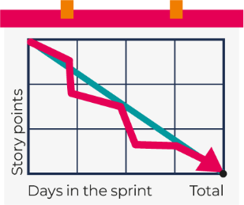
BURNDOWN CHART
Sprint burndown is a chart which represents progress of work during the sprint.
Burn-down Chart: shows the amount of work which is thought to remain in a backlog.
Burndown displays work outstanding
How to do it...
Have user stories
Estimate each user story together with your Development team in story points
Calculate total number of story points in sprint
Calculate total number of working days in sprint
Should be updated by the Development team at the same time every day
Notes:
Burn-down Chart: a chart which shows the amount of work which is thought to remain in a backlog. Time is shown on the horizontal axis and work remaining on the vertical axis. As time progresses and items are drawn from the backlog and completed, a plot line showing work remaining may be expected to fall. The amount of work may be assessed in any of several ways such as user story points or task hours. Work remaining in Sprint Backlogs and Product Backlogs may be communicated by means of a burn-down chart. See also: Burnup Chart
Burn-up Chart: a chart which shows the amount of work which has been completed. Time is shown on the horizontal axis and work completed on the vertical axis. As time progresses and items are drawn from the backlog and completed, a plot line showing the work done may be expected to rise. The amount of work may be assessed in any of several ways such as user story points or task hours. The amount of work considered to be in-scope may also be plotted as a line; the burn-up can be expected to approach this line as work is completed.

Slide 133

BURNDOWN CHART - EXAMPLE
Tasks | Mo | Tu | We | Th | Fr
Task 1 | 8 | 4 | 4
Task 2 | 16 | 12 | 10 | 7
Task 3 | 8 | 8 | 8 | 5 | 5
Task 4 | 12 | 8 | 8 | 5 | 5
Total: | 44 | 32 | 30 | 17 | 10
50
40
30
Points
20
10
0
Mo
Tu
We
Th
Fr

Slide 134
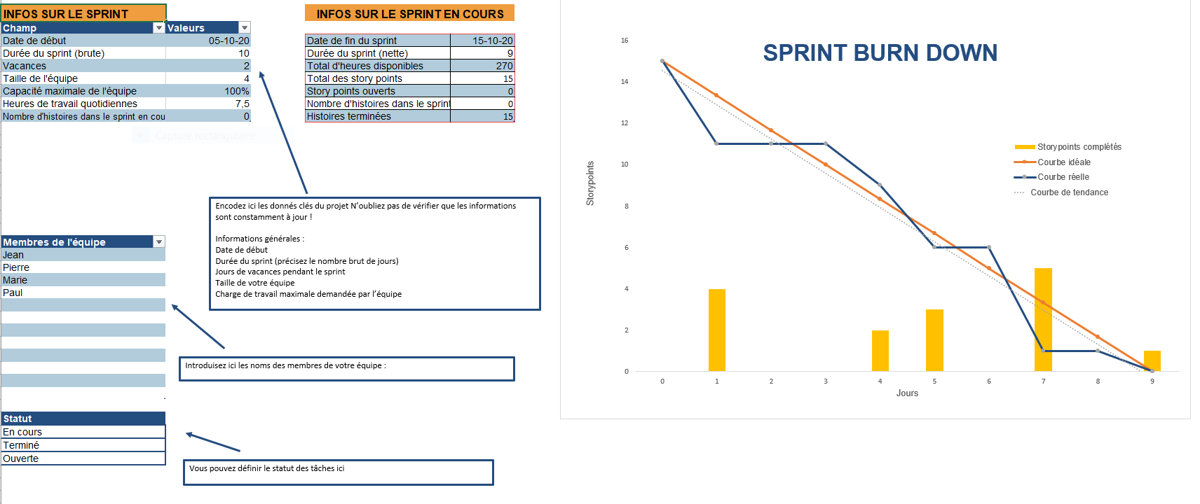
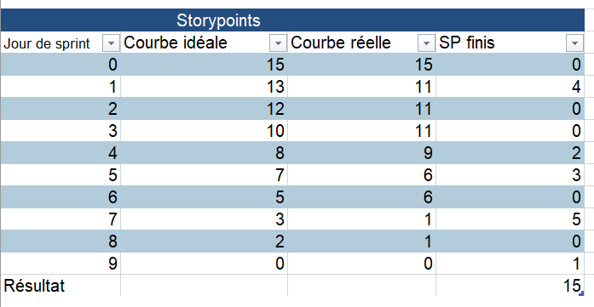
BURNDOWN CHART SHEET

Slide 135
Daily scrum & Impediments
“You aren’t going to fix problems in fifteen minutes—I don’t care how task-oriented you are.” “You’re right; that’s not what the stand-ups are for. They’re to point out problems—or what in Scrum we call ‘impediments’.”
― Jeff Sutherland

Slide 136
IMPEDIMENT (also Technical Debt)
Impediment is anything which is standing in team’s way towards achieving the sprint goal
Discovering Impediments:
One of the techniques to identify impediments is to ask a 4th question at standup.
‘How confident are you that you will achieve sprint goal?’
If it is anything less than 100%, by asking why, you will discover an impediment.
‘How can we go faster?’
Is another question to bring out impediments to the surface
FA FA points
FB FB points FC FC points
Impediments

Slide 137
IMPEDIMENTS – TIPS & TRICKS
Make the impediments visible—use special colour post-it notes for them Search for impediments.
Look out for impediment words (‘still waiting’, ‘not available’, ‘hopefully’, ‘wish’, ‘guess’, expected’, I thought’, ‘try’)
Limit the number of impediments. Select 3 biggest ones and put a big red dot on each of them. It will help the Development team focus
Help the Development team to resolve impediments
FA FA points
FB FB points FC FC points
Impediments

Slide 138
IMPEDIMENT BACKLOG
Any issue that prevents the Scrum Teams from being able to progress an activity should be placed on the Impediment Log.
Any issue that is highlighted and known to impact the Scrum Teams at a future date or future sprint, should be placed on the Impediment Log
It is the responsibility of Scrum Master to resolve impediments locally. If the impediments cannot be resolved locally, then these need to be raised at the Scrum-of-Scrum daily meetings for escalation
Anyone in the Team can raise an Impediment identifying a blocker to project progress.
FA FA points
FB FB points FC FC points
Impediments

Slide 139
BACKLOG REFINEMENT
- Scrum team, optional: stakeholders
- During sprint ( e.g. weekly)
- 30 min - 2 hours
Backlog refinement is an event to help the team to get user stories ready for future sprints i.e.
get user stories ready;
add detail to user stories;
estimate user stories;
identify risks and issues before sprint planning;
update priority of user stories.
removing user stories that no longer appear relevant
creating new user stories in response to newly discovered needs
re-assessing the relative priority of stories
assigning estimates to stories which have yet to receive one
correcting estimates in light of newly discovered information
splitting user stories which are high priority but too coarse grained to fit in an upcoming iteration
Backlog Grooming Agenda
Identify user stories to refine Clarify requirements for these user stories Identify open items/questions for these user stories and assign owners to them Break down user stories which are too big Discuss priority of these user stories and update if necessary Estimate user stories

Slide 140
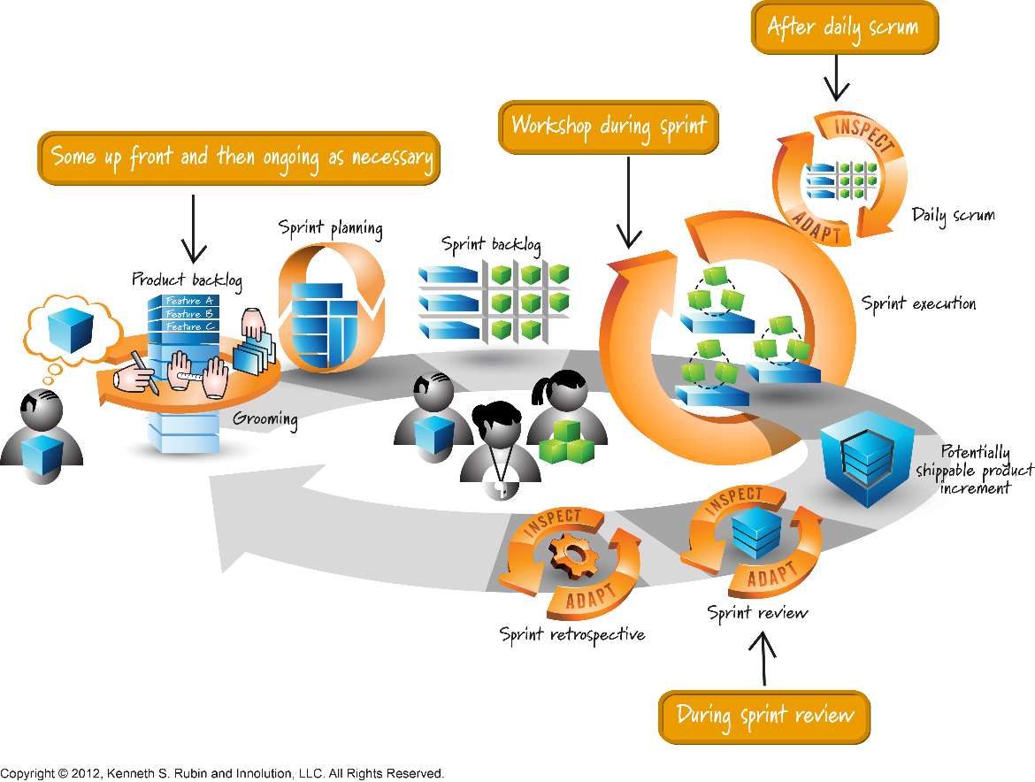
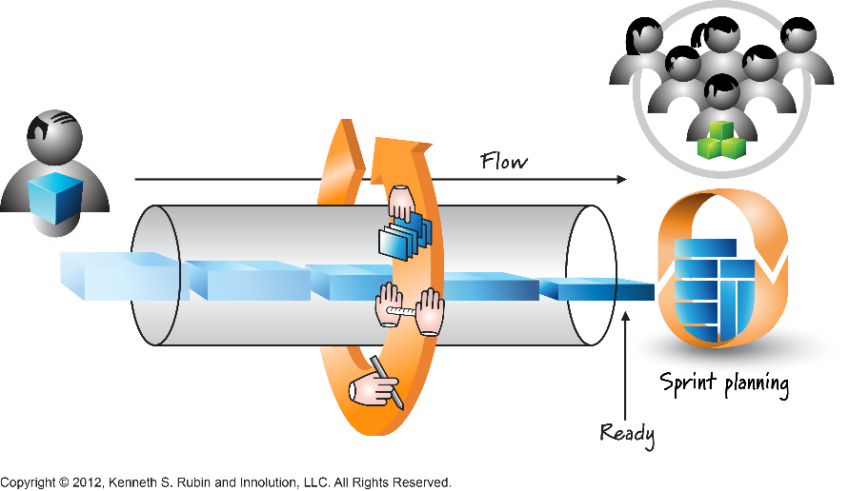
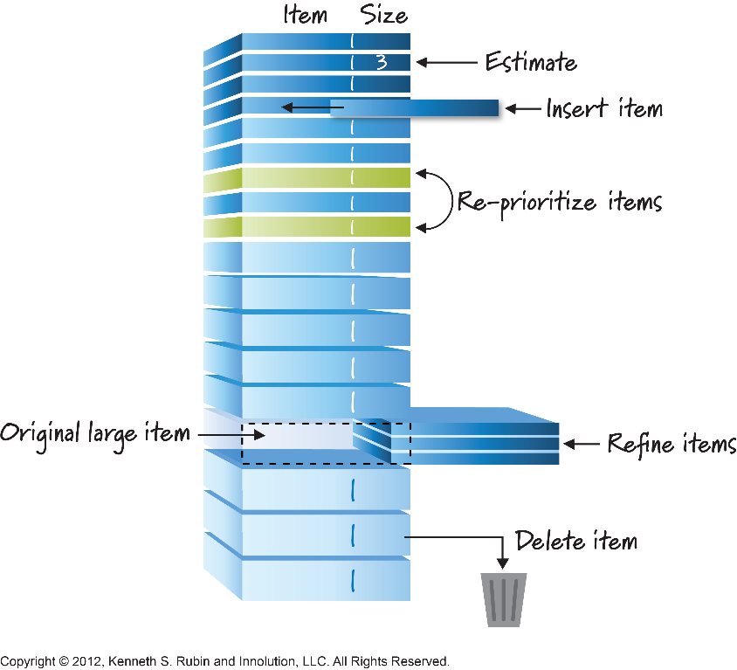
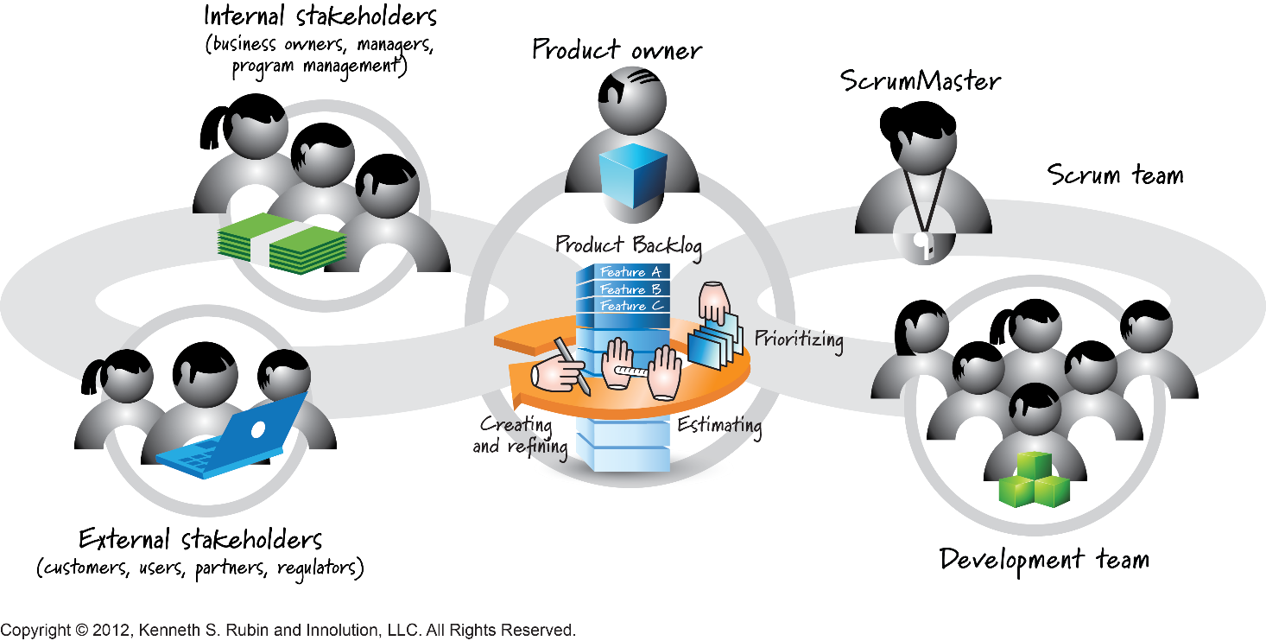
BACKLOG REFINEMENT

Slide 141
 | PRODUCT VISION
 | PRODUCT OWNER
A. | PRODUCT BACKLOG
C. | PRODUCT INCREMENT
 | SPRINT
 | SCRUM MASTER
 | DEVELOPMENT TEAM
1. | SPRINT PLANNING
 | SPRINT GOAL
B. | SPRINT BACKLOG
2. | DAILY SCRUM /STAND UP
 | BURNDOWN CHART
C. | PRODUCT INCREMENT
3. | SPRINT REVIEW
4. | SPRINT RETROSPECTIVE

Slide 142
C INCREMENT – “VERSION OF THE PRODUCT”
An Increment is a concrete stepping stone toward the Product Goal. Each Increment is additive to all prior Increments and thoroughly verified, ensuring that all Increments work together.
The Increment is the sum of all the Product Backlog items completed during a Sprint and the value of the increments of all previous Sprints. At the end of a Sprint, the new Increment must be "Done" – i.e. in useable condition and meet the Definition of Done (DoD).
*Sum of all Increments - as a whole - form a product.
Notes:
Increment
An Increment is a concrete stepping stone toward the Product Goal. Each Increment is additive to all prior Increments and thoroughly verified, ensuring that all Increments work together. In order to provide value, the Increment must be usable.
Multiple Increments may be created within a Sprint. The sum of the Increments is presented at the Sprint Review thus supporting empiricism. However, an Increment may be delivered to stakeholders prior to the end of the Sprint. The Sprint Review should never be considered a gate to releasing value.
Work cannot be considered part of an Increment unless it meets the Definition of Done.
Commitment: Definition of Done
The Definition of Done is a formal description of the state of the Increment when it meets the quality measures required for the product.
The moment a Product Backlog item meets the Definition of Done, an Increment is born.
The Definition of Done creates transparency by providing everyone a shared understanding of what work was completed as part of the Increment. If a Product Backlog item does not meet the Definition of Done, it cannot be released or even presented at the Sprint Review. Instead, it returns to the Product Backlog for future consideration.
If the Definition of Done for an increment is part of the standards of the organization, all Scrum Teams must follow it as a minimum. If it is not an organizational standard, the Scrum Team must create a Definition of Done appropriate for the product.
The Developers are required to conform to the Definition of Done. If there are multiple Scrum Teams working together on a product, they must mutually define and comply with the same Definition of Done.

Slide 143

3 SPRINT REVIEW
„ ... inspecting the Product Increment and adapting the Product Backlog if needed”
Notes:
Sprint Review: Scrum Event that is set to a time-boxed of 4 hours, or less, to conclude the development work of a Sprint. It serves for the Scrum Team and the stakeholders to inspect the Increment of product resulting from the Sprint, assess the impact of the work performed on overall progress and update the Product backlog in order to maximize the value of the next period

Slide 144
3 SPRINT REVIEW
A Sprint Review is held at the end of the Sprint to show what is accomplished, inspect the Increment and adapt the Product Backlog if needed i.e.
demonstrate results of sprint
discuss progress toward the Product Goal
discuss product and adjust product backlog
collaborate on the next goals
review timeline
Budget
release plan.
When: Last day each sprint before Sprint retrospective
Duration: 1 hour for every week of sprint (max 4 hours)
Who: Scrum team, stakeholders
Notes:
Sprint Review
The purpose of the Sprint Review is to inspect the outcome of the Sprint and determine future adaptations. The Scrum Team presents the results of their work to key stakeholders and progress toward the Product Goal is discussed.
During the event, the Scrum Team and stakeholders review what was accomplished in the Sprint and what has changed in their environment. Based on this information, attendees collaborate on what to do next. The Product Backlog may also be adjusted to meet new opportunities. The Sprint Review is a working session and the Scrum Team should avoid limiting it to a presentation.
The Sprint Review is the second to last event of the Sprint and is timeboxed to a maximum of four hours for a one-month Sprint. For shorter Sprints, the event is usually shorter.

Slide 145

3 SPRINT REVIEW - AGENDA
Agenda
Review meeting agenda and guidelines Development team walkthrough of completed functionality with product owner Development team demonstrates working software to stakeholders Development team discusses incomplete user stories Product owner moves/splits/re-prioritizes the backlog Product owner closes the sprint and accepts relevant functionality (if it wasn’t accepted during the sprint) Open actions/impediments are noted

Slide 146

4 SPRINT RETROSPECTIVE
„ ... Goos & bads - honest discussion about what worked well and what didn’t work well”
Scrum Team to inspect the past Sprint and plan for improvements to be enacted during the next Sprint.

Slide 147

4 SPRINT RETROSPECTIVE
“Goods & Bads”:
Sprint retrospective is an event for the Scrum team to reflect - honest discussion about what worked well and what didn’t work well. It encourages self-improvement and transparency.
All team members identify what went well and what can be improved e.g.
Processes
Communication
Environment
Artefacts
Tools
Team dynamics
When: Last day each sprint after Sprint review
Duration: max 3 hours
Who: Development team, SM
Notes:
Sprint Retrospective: Scrum Event that is set to a time-box of 3 hours, or less, to end a Sprint. It serves for the Scrum Team to inspect the past Sprint and plan for improvements to be enacted during the next Sprint.
Sprint Retrospective
The purpose of the Sprint Retrospective is to plan ways to increase quality and effectiveness.
The Scrum Team inspects how the last Sprint went with regards to individuals, interactions, processes, tools, and their Definition of Done. Inspected elements often vary with the domain of work.
Assumptions that led them astray are identified and their origins explored. The Scrum Team discusses what went well during the Sprint, what problems it encountered, and how those problems were (or were not) solved.
The Scrum Team identifies the most helpful changes to improve its effectiveness. The most impactful improvements are addressed as soon as possible. They may even be added to the Sprint Backlog for the next Sprint.
The Sprint Retrospective concludes the Sprint. It is timeboxed to a maximum of three hours for a one- month Sprint. For shorter Sprints, the event is usually shorter.

Slide 148
4 SPRINT RETROSPECTIVE – AGENDA
Agenda
Stages of retrospective: Set the stage Gather & analyze data Generate insights Decide what to do Close the retrospective
Practical examples:
Each development team member around the table says 3 words about previous sprint Ask everyone to write 3 post-it notes for ‘what went well’ and ‘what can be improved’ and stick them on the wall Group them into themes Identify the most painful item Brainstorm actions that can be taken in the next sprint to improve the item Thumb vote on how retrospective went

Slide 149
4 SPRINT RETROSPECTIVE – TAKE ACTION!
Make your actions SMART (specific, measurable, achievable, relevant and timely).
Assign owners to retrospective actions
Put all retrospective actions on Scrum board (sprint backlog)
Track them as any other work

Slide 150

KEYS TO SUCCESSFUL SCRUM TEAM
Roles of scrum master and product owner are performed by the right people
Scrum master and product owner have enough time to perform their duties
Development team is co-located
Members of the development team are dedicated to that team (100% allocated)
Development team is cross-functional
Development team is self-organised

Slide 151

Kanban
"Kan" means visual, and "ban" means card or board.
Physical card in Toyota Production System (TPS) for "pull" production control.
It has spread to the manufacturing industry all over the world as a tool of Lean Manufacturing.
Reference
Description
Quantity
Upstream Station
Downstream Station
Bar Code
Cycle Time

Slide 152

Kanban – Process
Kanban B
Kanban A
Need/Demand
Supplier
= Upstream
Station 1
Station 2
Customer = Downstream
KANBAN
Every Kanban (card) is unique and involves only 2 stations.
The Kanban is returned to the upstream station when the job is delivered
Limit = X
Upstream Station
Downstream Station

Slide 153







Kanban at GHdC
Kanban Recto
2. Visualizing Flipped Kanban Cards
Kanban Verso
1. Flipping Kanban cards over
Containers with 2 compartments
3. Scanning Kanban Cards
4. Re-supplying

Slide 154

Kanban for Agile Development WIP Limit and Board
Map the Value Stream Visualize the Work
Limit Work in Progress Establish a Cadence (Cycle/Lead Time)
Enable continuous improvement

Slide 155


Kanban Board
Reduce multi-tasking
Prevent context switching
Performing tasks sequentially yields results sooner
Maximize throughput
Enhance teamwork
Working together to make things done
Increase cross-functionality

Slide 156


Example from Kanban-land
1
3
4
2

Slide 157


Example from Kanban-land
5
7
6
8

Slide 158


Example from Kanban-land
9
11
10
12

Slide 159












Scrum of Scrums
Notes:
We only describe the phases at a very high level. RUP defines exit criteria, activities, and artifacts for each of these.
We don’t have time to go into them in that much detail.

Slide 160

Scaled Agile: LeSS, SAFe, DAD, Nexus
Notes:
We only describe the phases at a very high level. RUP defines exit criteria, activities, and artifacts for each of these.
We don’t have time to go into them in that much detail.

Slide 161

Scaled Agile: LeSS, SAFe, DAD, Nexus
Notes:
We only describe the phases at a very high level. RUP defines exit criteria, activities, and artifacts for each of these.
We don’t have time to go into them in that much detail.

Slide 162
RUP
Essentials of Rational Unified Process

Slide 163
UP Organization Along Time
time
Organization by phases helps minimize the risks of resource allocation.
Notes:
The time aspect of the process is enacted through phases, iterations, and milestones (end of phase objectives).
Progressing by meeting milestones helps minimize wasted resources since they are allocated only on a firm basis.

Slide 164
Major Milestones: Business Decision Points
Customer
acceptance
or end of life
Product sufficiently mature for customers
Architecture
baselined
Scope and Business Case agreement
Inception
Elaboration
Construction
Transition
time
Lifecycle
Objective
Milestone
Lifecycle
Architecture
Milestone
Initial Operational
Capability
Milestone
Product
Release
Notes:
The phases of RUP were chosen such that phase boundaries correspond to significant decision points in the life of a project. For example, at the end of Inception, enough work has been done to capture the problem to be solved, and a vision of the system has been developed. An initial set of risks has also been identified and evaluated. Based on this information, a decision is made whether to fund the project. Similar decision points correspond to the end of Elaboration, Construction, and Transition.
Milestones help you to assess the progress of a project at key points. Management can use these to establish clear criteria from which to decide the course of a project. They provide opportunities to change course. However, unlike the waterfall approach, phases contain iterations which yield executable results.
Phases represent the management perspective of the project, the “35,000 foot level.” The details are left to the engineering perspective, which is at the iteration level.
The names of the milestones are identical to the ones proposed by Barry Boehm in the article “Anchoring the Software Process,” IEEE Software, July 1996, pp. 73-82.

Slide 165
Inception Phase: Objectives
Establish project scope and boundary conditions
Determine the use cases and primary scenarios that will drive the major design trade-offs
Demonstrate a candidate architecture against some of the primary scenarios
Estimate the overall cost and schedule
Identify potential risks (the sources of unpredictability)
Prepare the supporting environment for the project
Notes:
Note: In addition to an estimate for the Elaboration phase, an overall estimate of cost and schedule to complete the project is usually made at this time. However, this estimate must be recognized as being very rough (low confidence) and subject to revision at the end of Elaboration.
We only describe the phases at a very high level. RUP defines exit criteria, activities, and artifacts for each of these.
We don’t have time to go into them in that much detail.

Slide 166
Inception Phase: Evaluation Criteria
Stakeholder concurrence on scope definition and cost/schedule estimates
Agreement that the right set of requirements has been captured and that there is a shared understanding of these requirements
Agreement that the cost/schedule estimates, priorities, risks, and development process are appropriate
All risks have been identified and a mitigation strategy exists for each
Milestone: Lifecycle Objectives (LCO)
Notes:
For more information, see RUP Lifecycle->Inception in RUP.

Slide 167
Elaboration Phase: Objectives
Define, validate and baseline the architecture as rapidly as is practical
Baseline the vision
Refine support environment
Baseline a detailed plan for the Construction phase
Demonstrate that the baseline architecture will support the vision at a reasonable cost in a reasonable period of time
Notes:
The cost and schedule to complete are re-estimated at the end of this phase. At this point they are considered stable (high confidence), and firm commitments can be made.

Slide 168
Elaboration Phase: Evaluation Criteria
Product Vision and requirements are stable.
Architecture is stable.
Key test and evaluation approaches are proven; major risk elements have been addressed and resolved.
Iteration plans for Construction phase are of sufficient detail and fidelity to allow work to proceed, and are supported by credible estimates.
All stakeholders agree that current vision can be met if the current plan is executed to develop the complete system, in the context of the current architecture.
Actual resource expenditures versus planned expenditures are acceptable
Milestone: Lifecycle Architecture (LCA)
Notes:
For more information, see RUP Lifecycle ->Elaboration in RUP.

Slide 169
Construction Phase: Objectives
Complete the software product for transition to production
Minimize development costs by optimizing resources and avoiding unnecessary scrap and rework
Achieve adequate quality as rapidly as is practical
Achieve useful versions (alpha, beta, and other test releases) as rapidly as possible

Slide 170
Construction Phase: Evaluation Criteria
The evaluation criteria for the Construction phase involve the answers to these questions:
Is this product release stable and mature enough to be deployed in the user community?
Are all the stakeholders ready for the product’s transition into the user community?
Are actual resource expenditures versus planned still acceptable?
Milestone: Initial Operational Capability (IOC)
Notes:
For more information, see RUP Lifecycle ->Construction in RUP.

Slide 171
Transition Phase: Objectives
Achieve user self-supportability
Achieve stakeholder concurrence that deployment baselines are complete and consistent with the evaluation criteria of the vision
Achieve final product baseline in a rapid and cost-effective manner
Notes:
During the Transition phase, a decision is made whether to release the product.

Slide 172
Transition Phase: Evaluation Criteria
The primary evaluation criteria for the Transition phase involve the answers to these questions:
Is the user satisfied?
Are actual resources expenditures versus planned expenditures acceptable?
Milestone: Product release (“GA”)
Notes:
The decision about whether to release the product will be based primarily on the level of user satisfaction achieved during the Transition phase. Often this milestone coincides with the initiation of another development cycle to improve or enhance the product. In many cases, this new development cycle may already be underway.
For more information, see RUP Lifecycle ->Transition in RUP.

Slide 173
Disciplines
Be introduced to the content of RUP and its application by investigating:
UP disciplines
Requirements
Business Modeling
Configuration & Change Management
Environment
Project Management
Analysis & Design
Implementation
Test
Deployment
Notes:
This module describes major elements of disciplines and follows an order as described below.
You will recognize that we have emphasized artifacts (deliverables) rather than workflow details and activities, which make higher level presentation rather cumbersome and potentially boring to students because few details can be covered.
Another objective is to show the interconnectivity between disciplines - how they cooperate in the common cause of delivering the system.
The Requirements discipline section is much longer than the rest because we cover use cases in some detail. We concentrate on features, use-case models and supplementary specifications. Business modeling is covered next emphasizing what system development can benefit from it. Next we concentrate on the system we are building by showing a configuration. We then cover Environment by showing a development case as well as artifact and tool specifics. Project Management is covered in summarized form because we have addressed many of its features in an earlier module.
The rest is downhill…

Slide 174
Review: UP Organization Based on Content
UP content is organized into disciplines.
Discipline: a collection of activities that are all related to a major “area of concern.”
Requirements
Implementation
Test
Deployment
Configuration & Change Management
Analysis & Design
Project Management
Environment
Business Modeling

Slide 175

UP Disciplines
Artifacts from each discipline evolve over the iterative process.
Notes:
Students have seen information on this slide already, but a quick review here is appropriate.
Grouping activities into disciplines is mainly an aid to understanding the project from a 'traditional' waterfall perspective. Typically, for example, it is more common to perform certain requirements activities in close coordination with analysis and design activities. Separating these activities into separate disciplines makes the activities easier to comprehend.

Slide 176
Requirements Discipline
Purpose
Establish and maintain agreement with the customers and other stakeholders on what the system should do
Provide system developers with a better understanding of the system requirements
Define the boundaries of (delimit) the system
Provide a basis for planning the technical contents of iterations
Provide a basis for estimating cost and time to develop the system
Define a user-interface for the system, focusing on the needs and goals of the users
Notes:
For more information, see Disciplines->Requirements.

Slide 177
Business Modeling Discipline
Purpose
Understand problems in target organization and identify potential improvements
Ensure customer and end user have common understanding of target organization
Derive system requirements to support target organization
Understand structure and dynamics of organization in which system is to be deployed
This discipline uses an approach very similar to that of system development
Notes:
For more information, see Disciplines->Business Modeling.

Slide 178

Configuration & Change Management Discipline
Purpose: controls change to, and maintains the integrity of, a project’s artifacts.
Notes:
Change Request Management (CRM) addresses the organizational infrastructure required to assess the cost, and schedule, impact of a requested change to the existing product. Change Request Management addresses the workings of a Change Review Team or Change Control Board.
Measurement is used to describe the state of the product based on the type, number, rate and severity of defects found, and fixed, during the course of product development. Measurements derived under this aspect, either through audits or raw data, are useful in determining the overall completeness status of the project.
Change tracking, enabled by measurement describes what is done to components for what reason and at what time. It serves as history and rationale of changes. It is quite separate from assessing the impact of proposed changes as described under 'Change Request Management'.
Configuration Management (CM) describes the product structure and identifies its constituent configuration items that are treated as single versionable entities in the configuration management process. CM deals with defining configurations, building and labeling, and collecting versioned artifacts into constituent sets and maintaining traceability among these versions.
Version selection is used to ensure that right versions of configuration items are selected for change or implementation. Version selection relies on a solid foundation of 'configuration identification'.
Software Manufacture enables automation of compiling, testing and packaging software for distribution.
For more information, see Disciplines->Configuration and Change Management.

Slide 179
Environment Discipline
Purpose: Focuses on the activities necessary to configure the process for a project. Defines what improvements are realistic under the project’s circumstances:
Current process
Current tools
Current staff skills and capabilities for change
Current problems and possible improvement objectives
Notes:
The Environment discipline supports the development organization with processes and tools. Many of the tasks associated with the process can benefit from the use of tools. Tools include those for modeling, testing, requirements management, coding, planning and tracking. Some tools may be developed internally.
Process configuration involves adapting the process to the needs of a software development organization. RUP is a framework which is modified for an organization.
For more information, see Disciplines->Environment.

Slide 180
Project Management Discipline
Purpose:
Provide a framework for managing software-intensive projects.
Provide practical guidelines for planning, staffing, executing, and monitoring projects.
Provide a framework for managing risk.
Main artifacts are:
Project Plan
Risk Management Plan
Business Case
Iteration Plans
Notes:
The Project Plan describes the phases and major milestones the project will follow.
The Risk Management Plan details how to manage the risks associated with a project. It details the risk management tasks that will be carried out, assigned responsibilities, and any additional resources required for the risk management activity. This plan may be embedded in the Software Development Plan.
The Business Case provides the necessary information from a business standpoint to determine whether this project is worth investing in.
The Iteration Plan is a time-sequenced set of activities and tasks, with assigned resources, containing task dependencies, for the iteration. It is a fine-grained plan.
For more information, see Disciplines->Project Management.

Slide 181
Scope In Project Management
Product Vision Document
The “essence” of the product
Key needs from the stakeholders
Key features of product
Defines criteria for success
Basis for requirement definition
Business Case
Financial forecast
Summary of product (refers to vision)
Estimate of expenditures
Expected Return on investments
Constraints
Multiple scenarios (refers to risks)
A few pages (1 to 12)
A few pages (1 to 12)

Slide 182
Iteration Plan
Focus during Inception and Elaboration
Project scoping and risk reduction, especially architectural risks
Focus during Construction and Transition
Development efficiency and product quality
Notes:
For more information, see Disciplines->Project Management->Artifact Overview.

Slide 183
Planning for Iterative Development
Project Plan
Phase Plan
Iteration Plan (current)
Phases and major milestones
What and when
Iterations for each phase
Number of iterations
Objectives
Duration
Iteration Plan (next)
“Roadmap”
Coarse-grained
Plan
Fine-grained Plans
Notes:
The Project Plan, Phase Plan and Iteration Plan are all components of the Software Development Plan artifact which is a major artifact in the Project Management discipline.
The Project Plan is a coarse-grained plan, and there is only one per development project. It captures the overall envelope of the project, for one cycle (and maybe the following cycles, if appropriate).
The Project Plan is produced very early in the Inception phase and updated as often as necessary.
The Iteration Plan is a time-sequenced set of activities and tasks, with assigned resources, containing task dependencies, for the iteration. It is a fine-grained plan, and there is one per iteration. A project usually has two iteration plans active at any given point:
The current iteration plan (that is, for the current iteration) which is used to track progress
The next iteration plan (that is, for the upcoming iteration) which is built toward the second half of the current iteration, and is ready at the end of the current iteration
A good point to make is that there is no value in developing a detailed project plan during inception, since it will change as we learn more about the project. So we develop the overall plan just at the highest level and then incrementally generate detailed iteration plans when the time to start the iteration draws near. That way we don’t waste time.
Note: This view is conceptual. Neither the Project Plan, Phase Plan, or Iteration Plan are necessarily artifacts. They are sections of the Software Development Plan.
Discussion point: Ask students how frequently they update plans on their projects.

Slide 184



What You Can Do in the RUP Planning Guide
Wizards allow you to select how many iterations you want in each phase, as well as which discipline-based RUP activities you want in each iteration.
Wizards allow you to select what deliverables you want in each iteration, and to attach activities or roles to them.

Slide 185
Analysis & Design Discipline
Purpose:
Transform the requirements into a design of the system-to-be
Evolve a robust architecture for the system
Adapt the design to match the implementation environment
Primary artifact is the Design Model.
Notes:
For more information, see Disciplines->Analysis & Design.

Slide 186
Implementation Discipline
Purpose:
Implement classes and objects in terms of components and source code
Define the organization of the components in terms of implementation subsystems
Test the developed components as units
Create an executable system
Primary artifact is Implementation Model.
Notes:
The testing scope of the Implementation discipline is limited to unit test of individual components. System test and integration test are described in the Test discipline. At the system test level, the Implementation and Test disciplines are, in practice, interwoven.
Key concepts:
Build - An operational version of a system or part of a system that demonstrates a subset of the capabilities provided in the final product
Integration - Combining separate software components into a whole
Prototypes - Used to check business viability, to demonstrate key technology, to obtain project commitment or funding, to further understand requirements, to check usability
For more information, see Disciplines->Implementation.

Slide 187
Test Discipline
Purpose:
Finding and documenting defects in software quality
Generally advising about perceived software quality
Proving the validity of the assumptions made in design and requirement specifications through concrete demonstration
Validating the software product functions as designed
Validating that the requirements have been implemented appropriately
The Test discipline:
Focuses primarily on the evaluation or assessment of quality realized through a number of core practices
Acts in many respects as a service provider to the other disciplines
Notes:
The RUP Test Discipline is:
Centered on iterative testing process
Scalable and customizable
Designed for flexibility
Focused on efficiency
The Test discipline presents a process and set of recommended practices to guide your testing effort. Unlike traditional waterfall testing process, RUP advocates an iterative approach to testing. Iterative testing allows you to:
Mitigate high risks earlier in the development process.
Focus your resources when and where they can have the most impact.
Maximize your effectiveness by adapting your approach, process, or assets as you go.
The RUP Test Discipline is designed to be flexible and adaptable. Its process framework can support different sized organizations. And, its recommended approach can be adapted to formal or informal testing practices within an organization.
The primary focus of the Test Discipline is on maximizing the effectiveness of an organization’s testing efforts.
For more information, see Disciplines->Test.

Slide 188
Deployment Discipline
Purpose: Manage the activities associated with ensuring that the software product is available for its end users, such as:
Product deployment
Testing at the installation and target sites
Beta testing
Creating end-user support material
Creating user training material
Releasing to customer (in the form of shrink- wrapped package, download site, etc.)
Notes:
Producing the Deployment Unit - creating a deployment Unit (build, documentation and installation) that is sufficiently complete to be downloadable, and run on a node
Beta Testing - implementing a beta program to solicit feedback on the product under development from a subset of the intended users
Packaging the Product - taking the deployment unit, installation scripts, and user manuals, then packaging them for mass production like any other consumer product
Distributing the Software - making the product available for purchase and download over the Internet, or as a packaged product
For more information, see Disciplines->Deployment.

Slide 189

From UP to SCRUM: OpenUP
Source: http://epf.eclipse.org/wikis/openup/

Slide 190

OpenUP Lifecycle
Is a delivery process defining an end-to-end software development lifecycle
Designed to support small, co-located teams in their daily activities.

Slide 191
Roles
Basic
Analyst
Any role
Deployment
Course developer
Environment
Process Engineer
Tool Specialist
Deployment engineer
Deployment manager
Product owner
Technical writer
Trainer
Architect
Developer
Project manager
Stakeholder
Tester

Slide 192

OpenUP roles from a Scrum Perspective
Analyst, Architect, Developer, Tester, and likely the Project Manager
Developers
Scrum Master
May be the Project Manager, but not recommended
Stakeholder, may in some cases be the Project Manager – whose neck gets wrung when things go wrong?
Product Owner

Slide 193
Disciplines
Architecture
Deployment
Development
Environment
Project Management
Requirements
Test
how to plan for and deploy a solution
create software architecture from architecturally significant requirements.
how to design and implement a technical solution that conforms to the architecture and supports the requirements
how to customize process and tools for a project or organization
how to elicit, analyze, specify, validate, and manage the requirements for the system to be developed
how to coach, facilitate, and support the team, helping it to deal with risk and obstacles found when building software
how to provide feedback about the maturing system by designing, implementing, running, and evaluating tests

